Slide 1
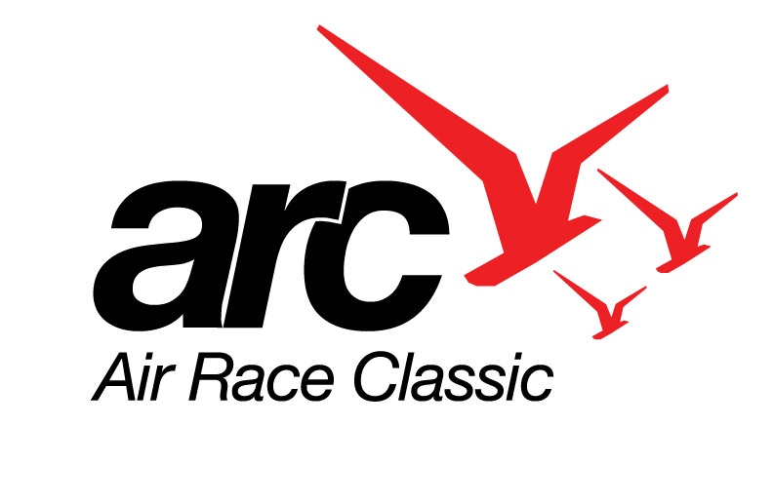
Flying the Air Race Classic
Presented to the Ninety-Nines

Slide 2

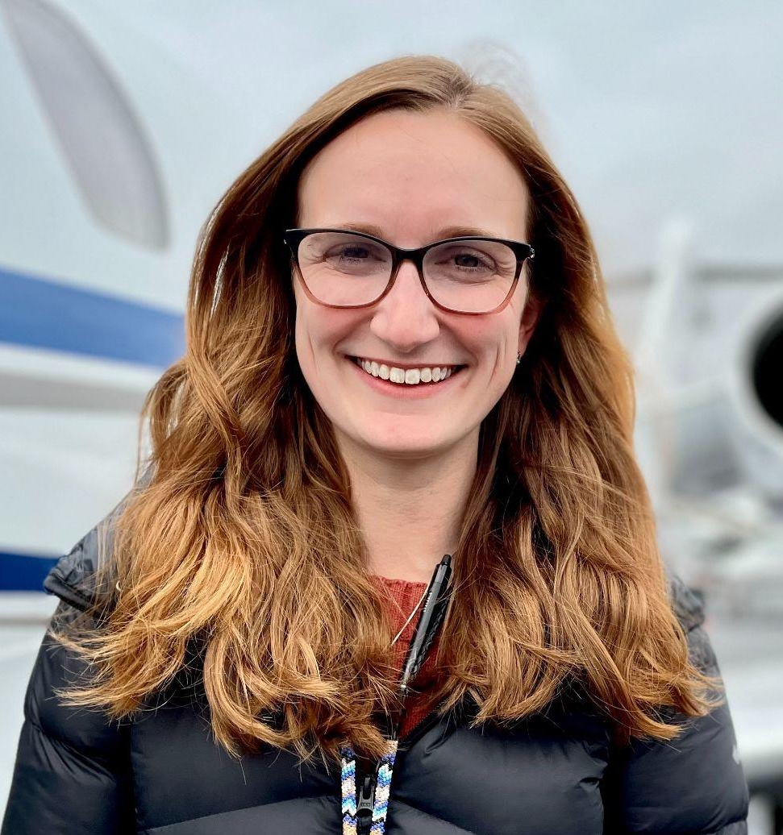
Emmy Dillon
ARC Director of Education
Racer
Notes:
Emmy:
Thank you for inviting us to talk to you tonight about the Air Race Classic
We are here to give you a little history of air racing
Talk about who races with us
Give you a peek into a Day in the Life of a race team
Help you navigate our website
And
To provide some resources to help you further explore racing with us
I’m Emmy Dillon – the Director of Education for the ARC. I’ve been a racer since 2015 and a board member since 2020
Also with me is Lara Gaerte who has been racing since 2004, a director since 2010, and the ARC President from 2014-2023.
As well as Theresa White, a board member since 2008 and three time racer
Between our collective time of almost 60 years we are here to share our passion for the Air Race Classic with you

Slide 3
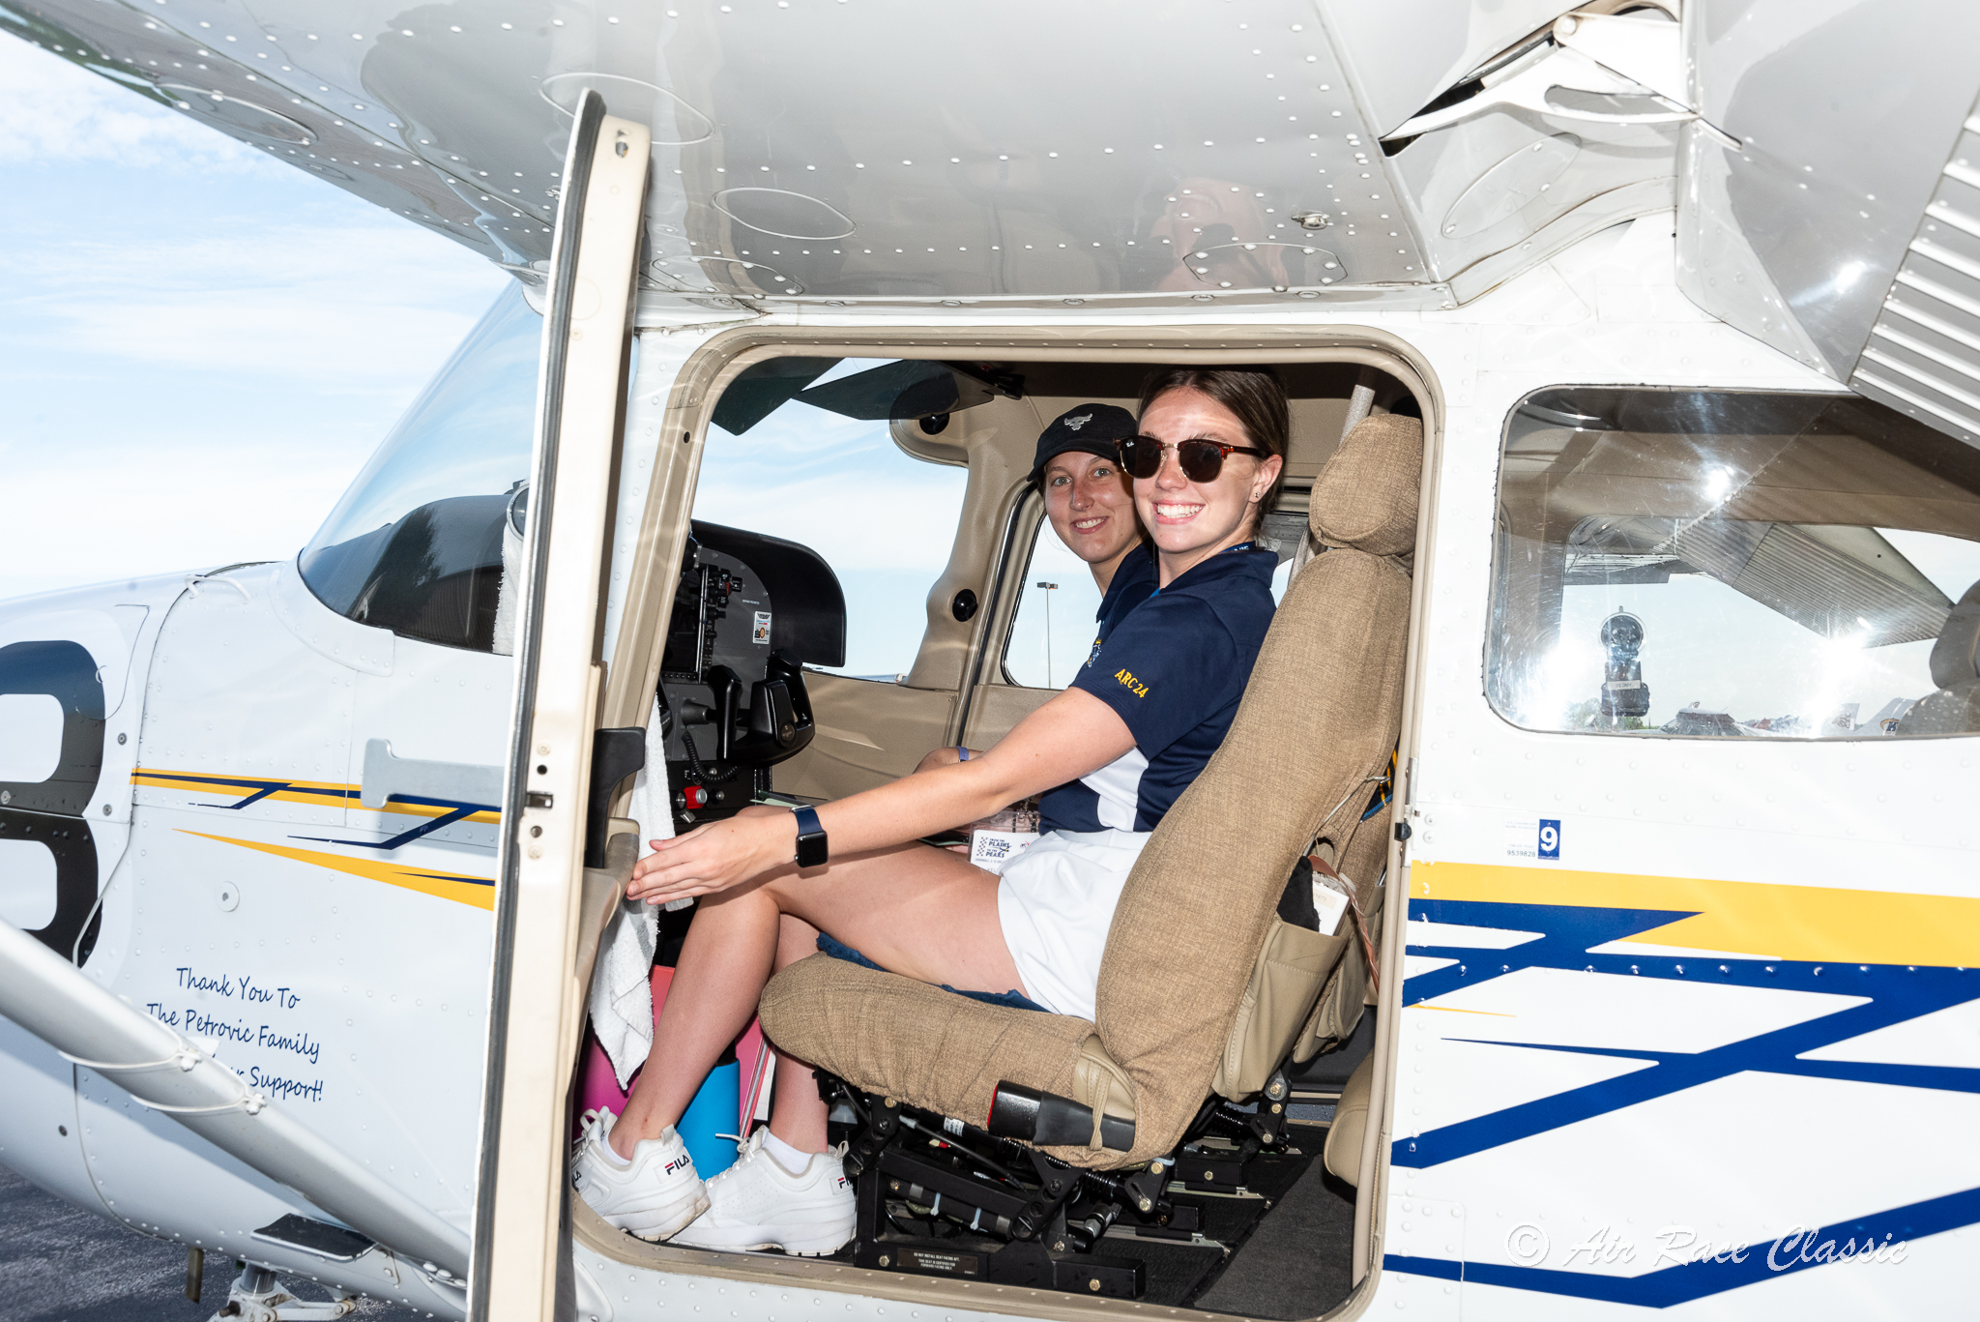
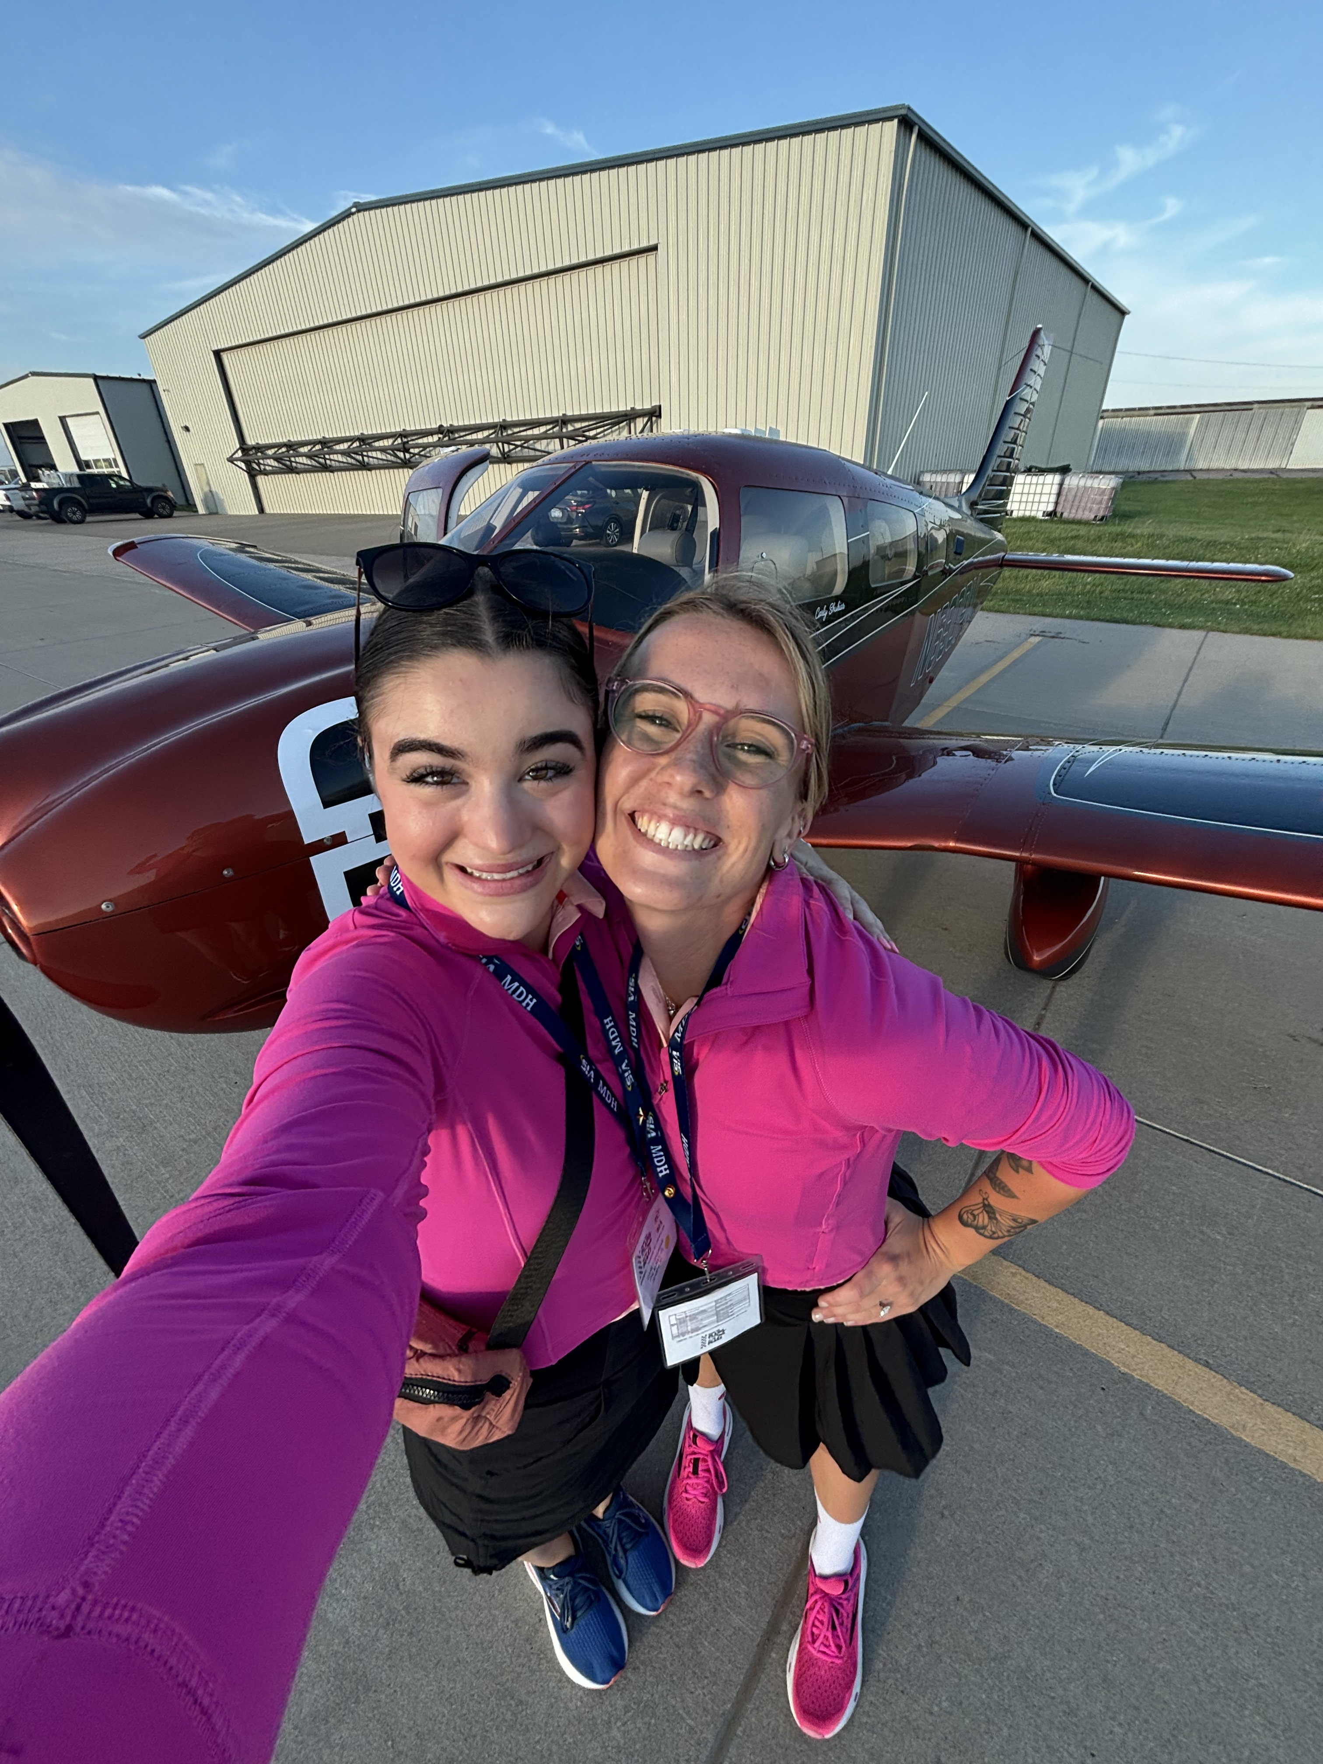
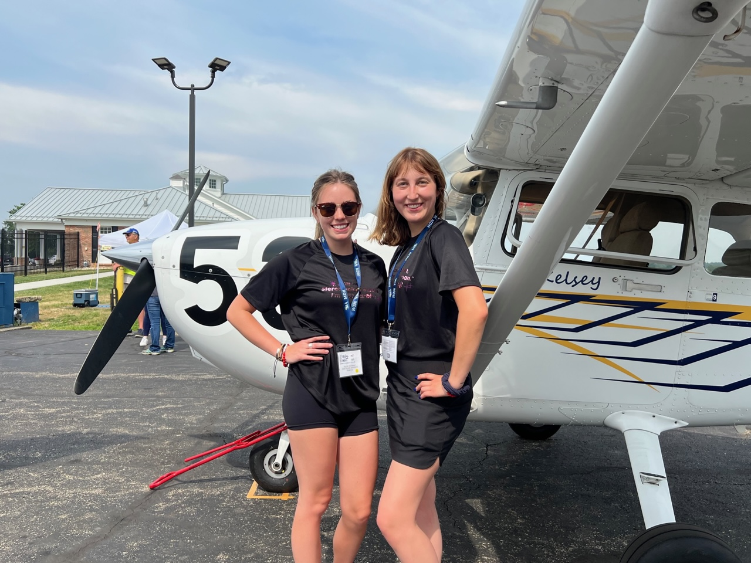
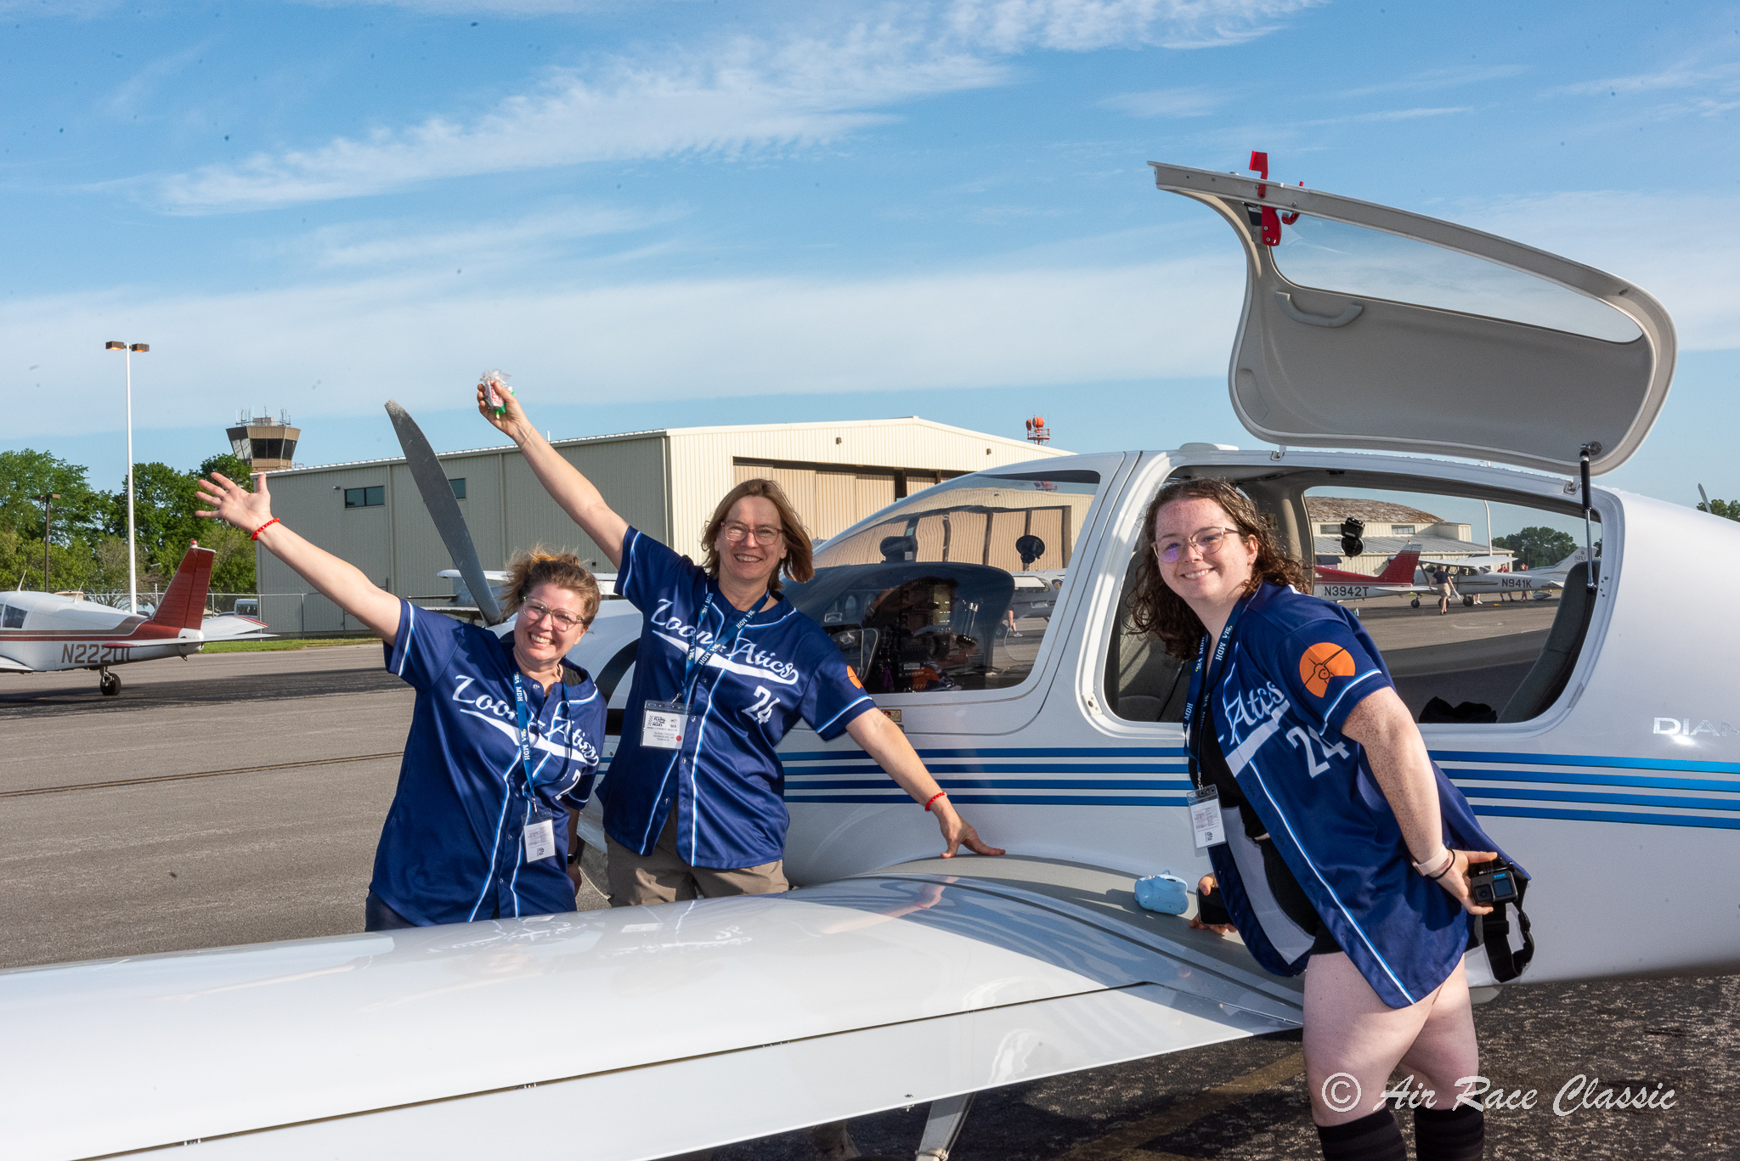
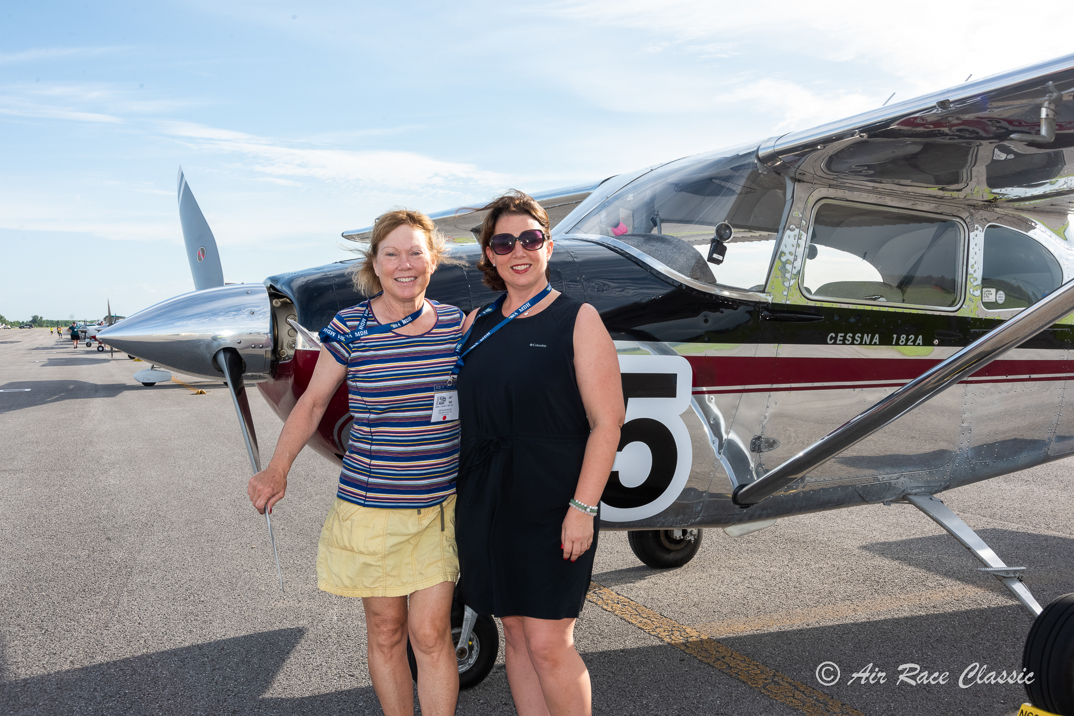
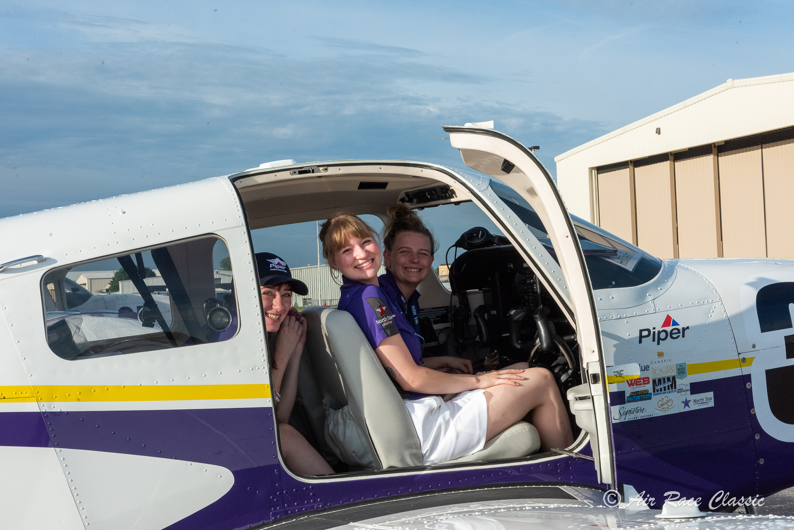
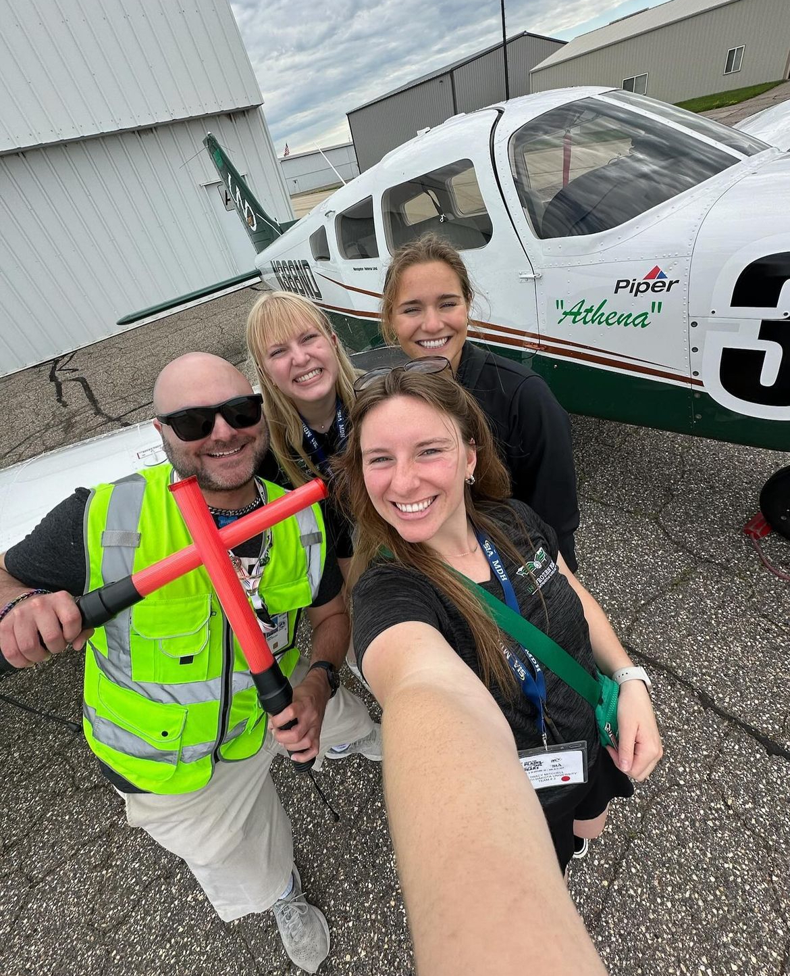
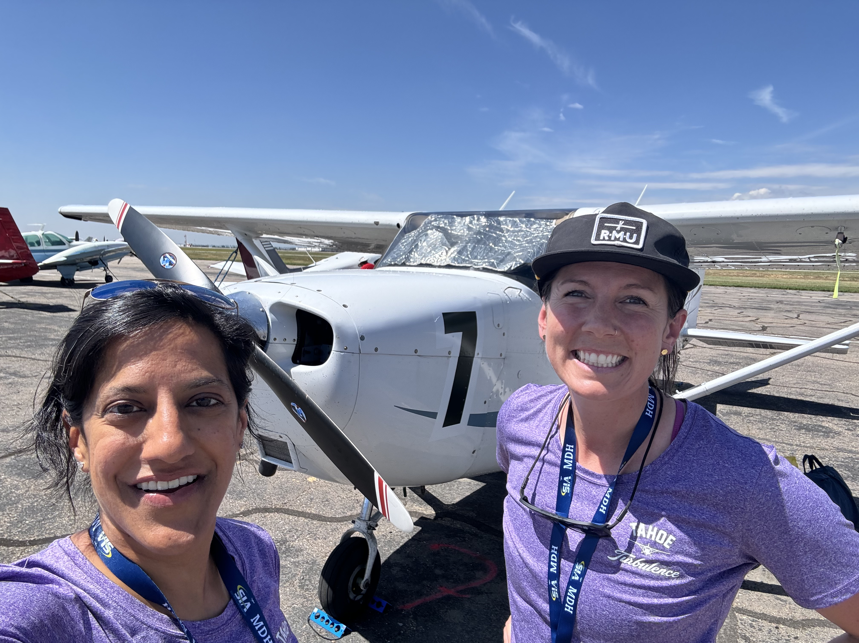
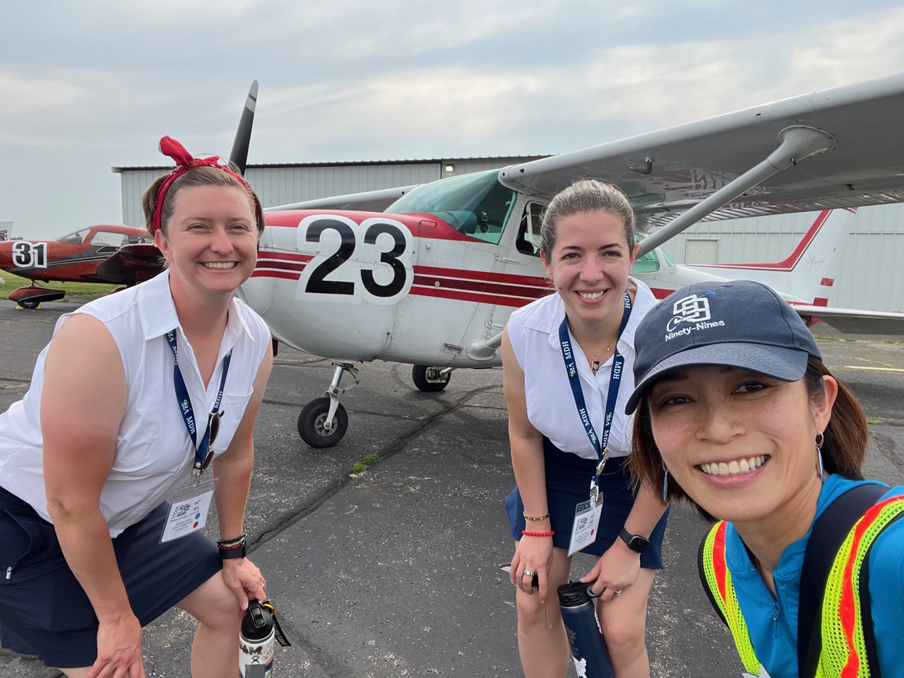
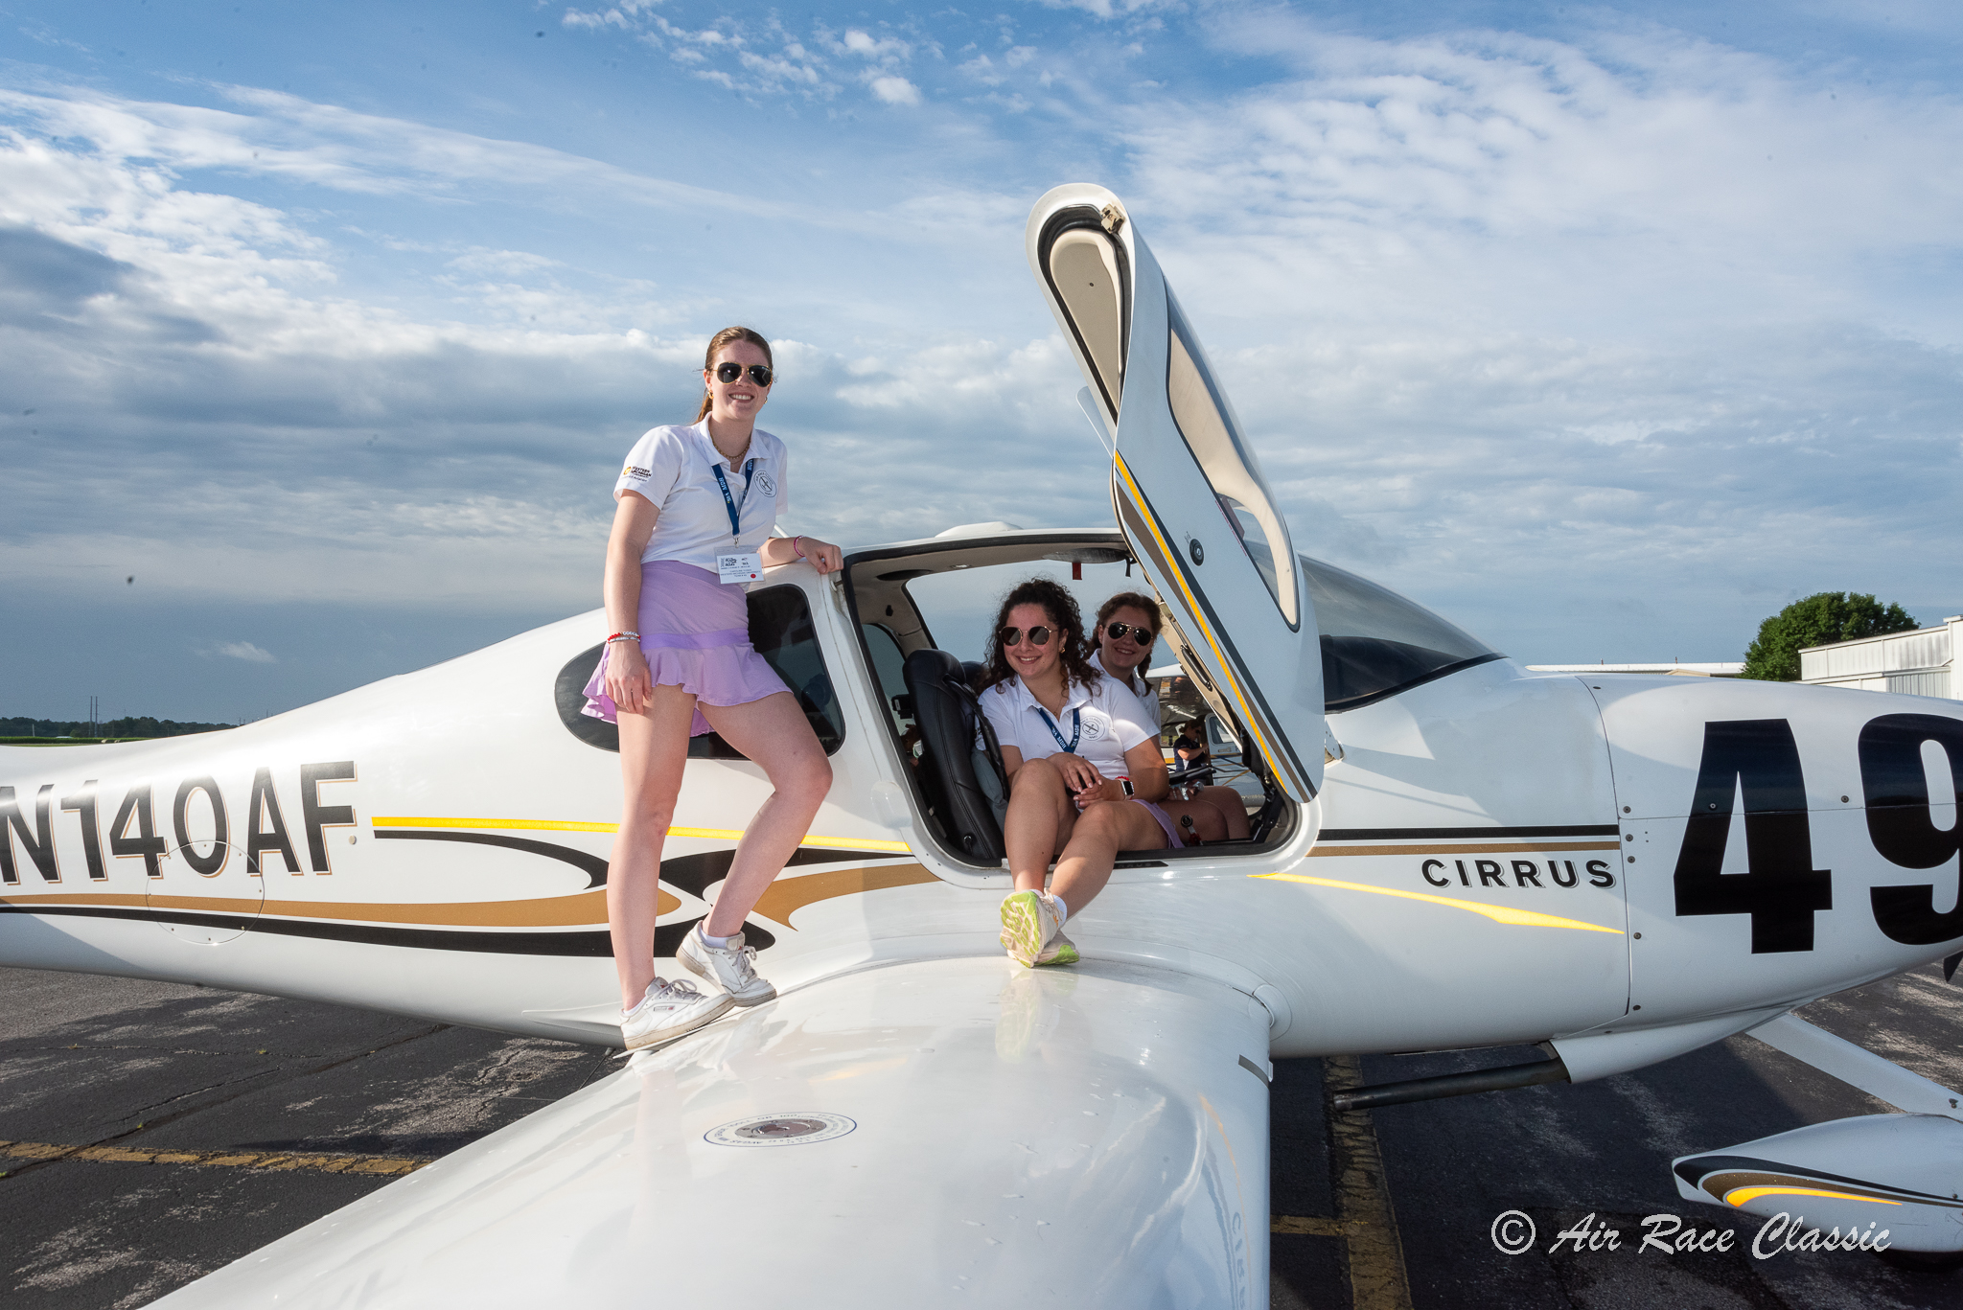
What is the ARC?
An all-women’s transcontinental air race
Flying ~2,400nm
4-Days
Daytime VFR
Notes:
To let us get a feel for who’s with us tonight
Please note in the Chat…..

Slide 4


Slide 5
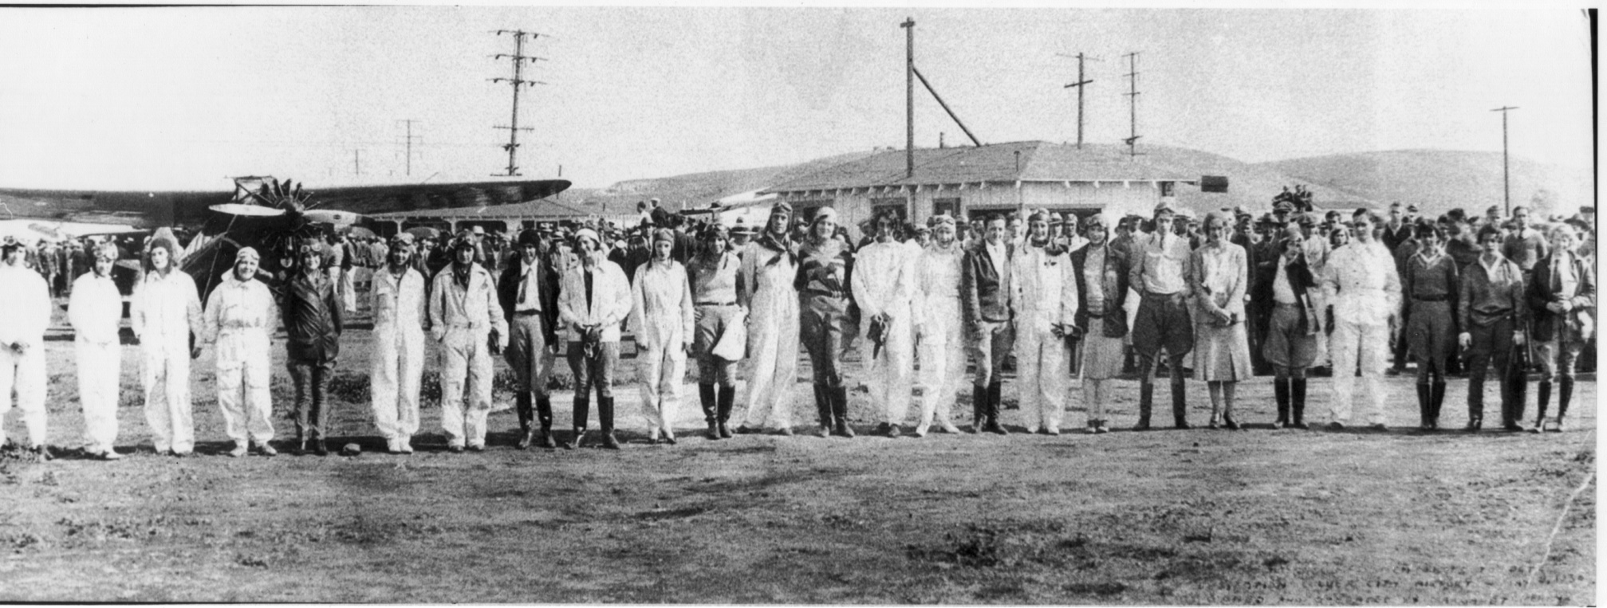
Quick History of the ARC
FIRST WOMEN’S AIR RACE
1929 National Air Races – Santa Monica, CA to Cleveland, OH
20 Competitors, 2 Classes, Single Day Speed Challenges Over 8 Days
Sponsored by the National Exchange Club
Winners– Louise Thaden and Phoebie Omlie
Notes:
Emmy
To give you a little background I’ll start with the first women’s air race. Almost as soon as Orville and Wilbur launched their first plane, men started racing airplanes.
It wasn’t until 1929, however, when women were first given the opportunity to race when The National Exchange Club sponsored an “add on” feature to the mens races that year.
It was an 8 day race from Santa Monica, CA to Cleveland Ohio.
There were 2 classes based on engine power and 20 women, which included celebrity pilots like Amelia Earhart, who placed 3rd, and Pancho Barnes, who won the 1930 women’s air derby.

Slide 6
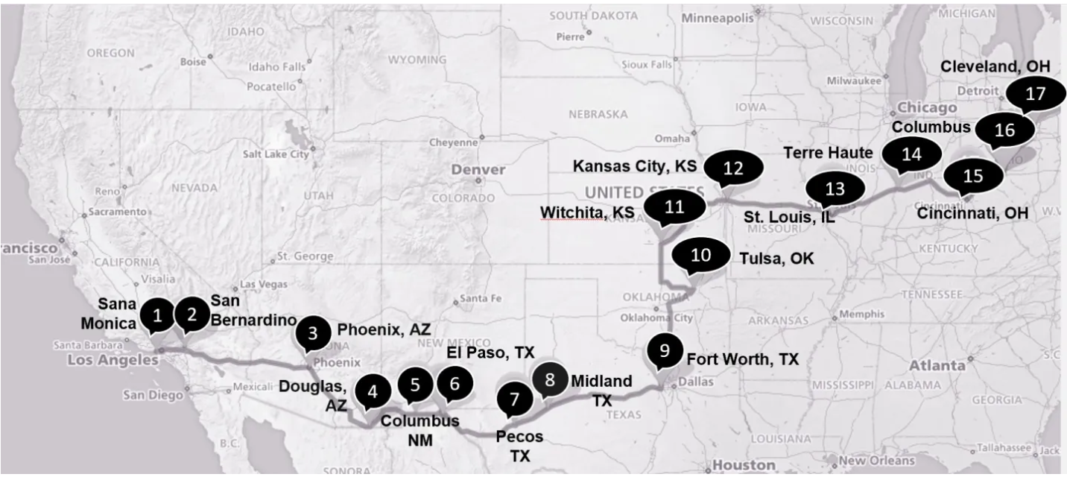
1929 Women’s Air Derby Route Map
Notes:
Emmy

Slide 7
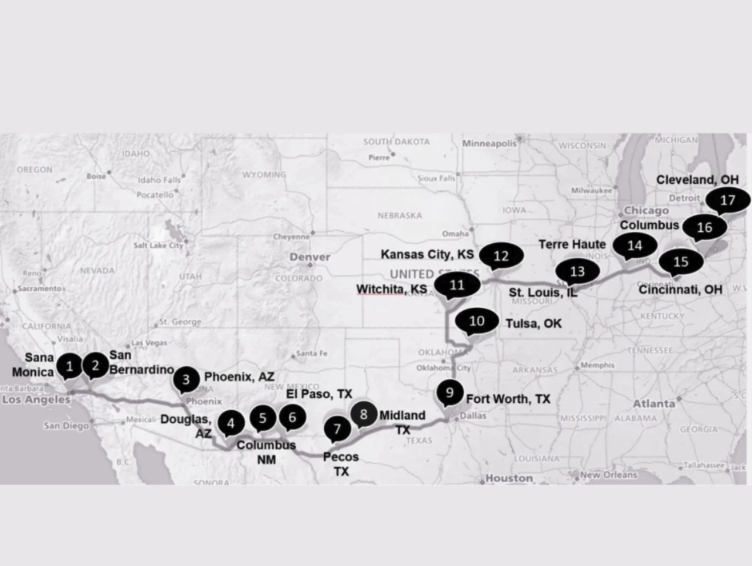
Route Maps Since 1929
Notes:
Emmy

Slide 8
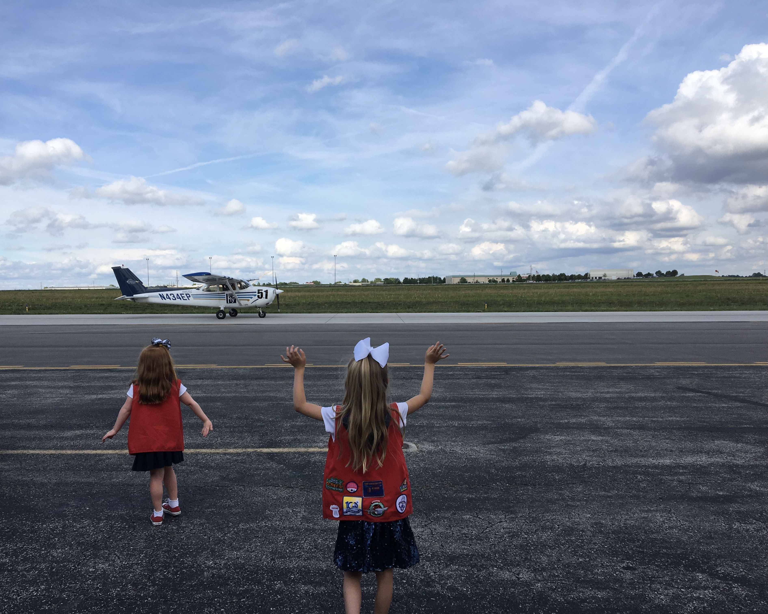
From Powder Puff to ARC
Incorporated in 1977, the Air Race Classic continues the tradition of women’s air racing into the future via their Mission:
Encourage and Educate Women Pilots
Increase Public Awareness of General Aviation
Demonstrate Women’s Roles in Aviation
Preserve and Promote Pioneering Women in Aviation
Notes:
The race has been continuously running and only missed 2 years during WW2, during the oil embargo in 1974, and 2020/21 due to Covid
It was more popularly known as the Powder Puff Derby (Will Rogers)
The Race was actually owned and run by the Ninety-Nines for two years.
The All Women’s Transcontinental Air Race organization or AWTAR ran the race until it was re-incorporated as the Air Race Classic in 1977
The top right picture is our current Board of Directors. You may recognize some of all of us – we are all 99s!
QUESTIONS about History?

Slide 9
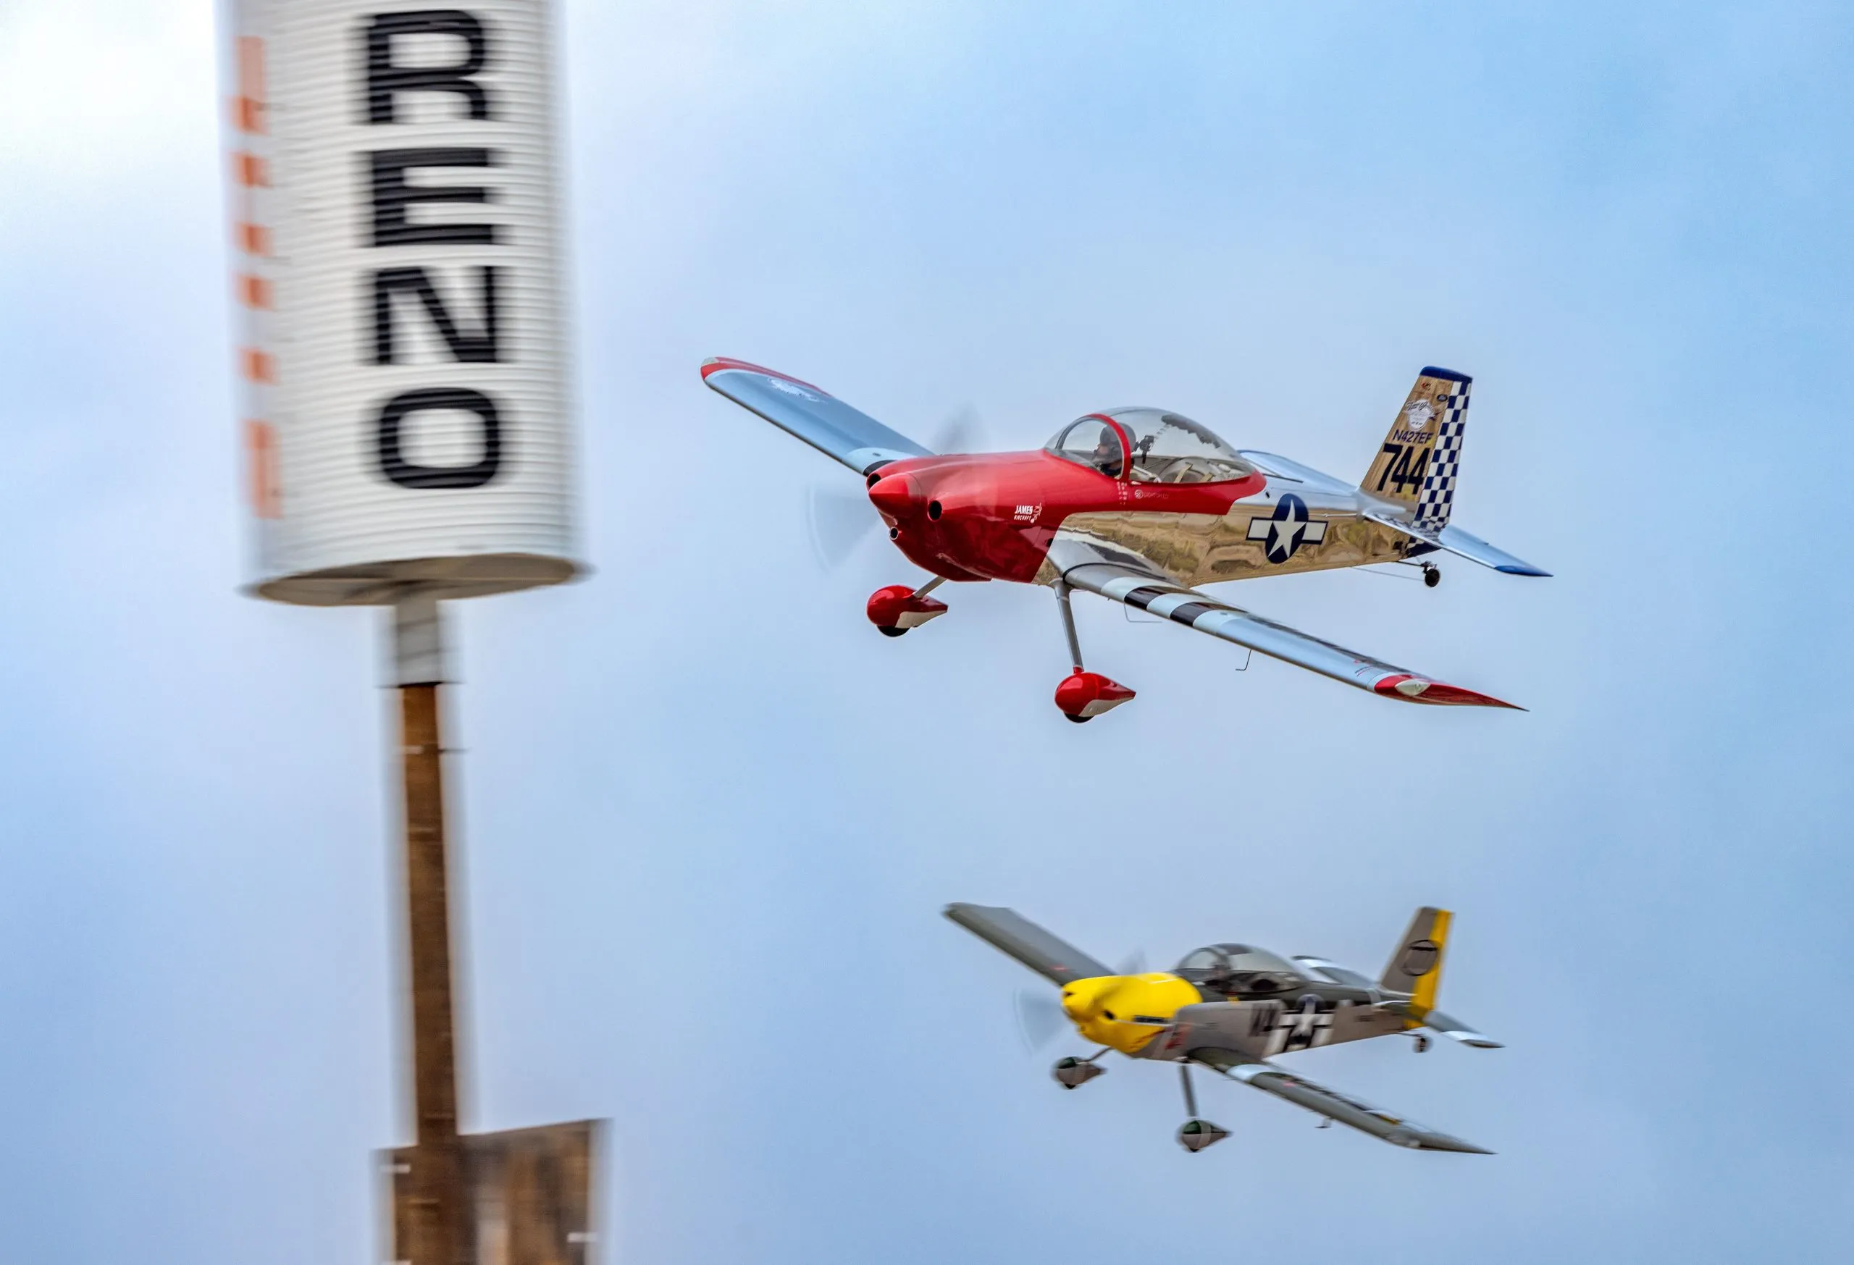
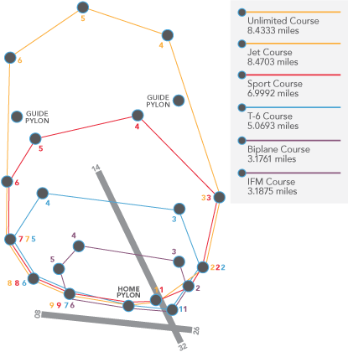
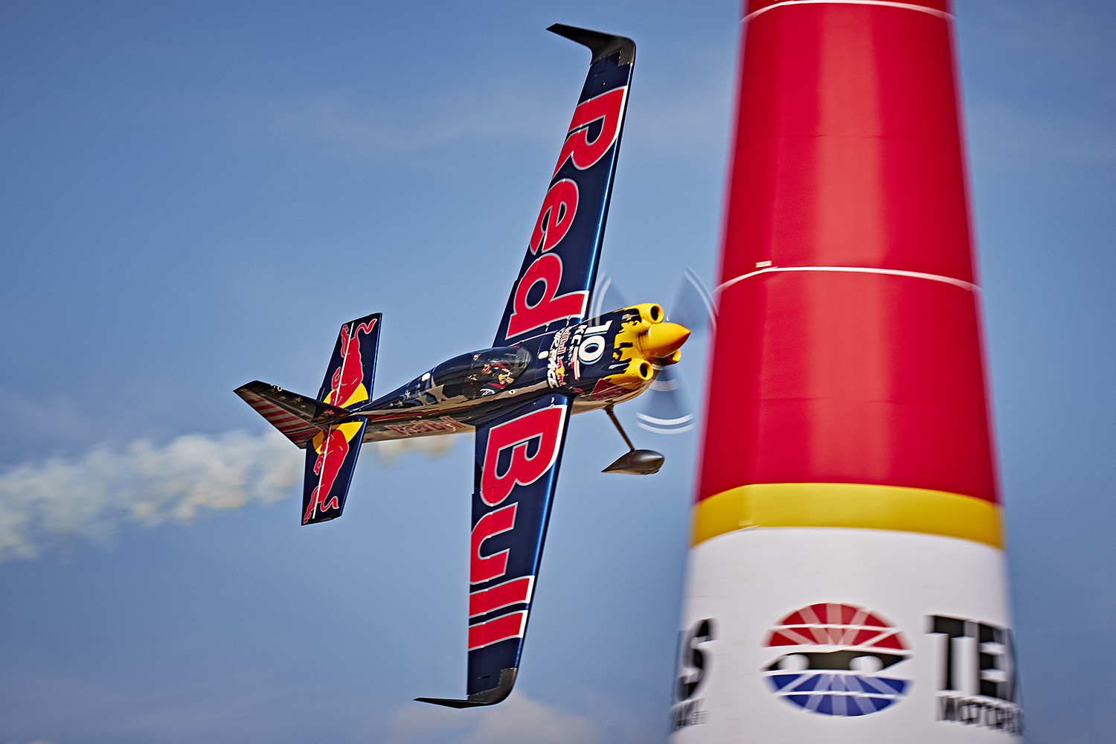
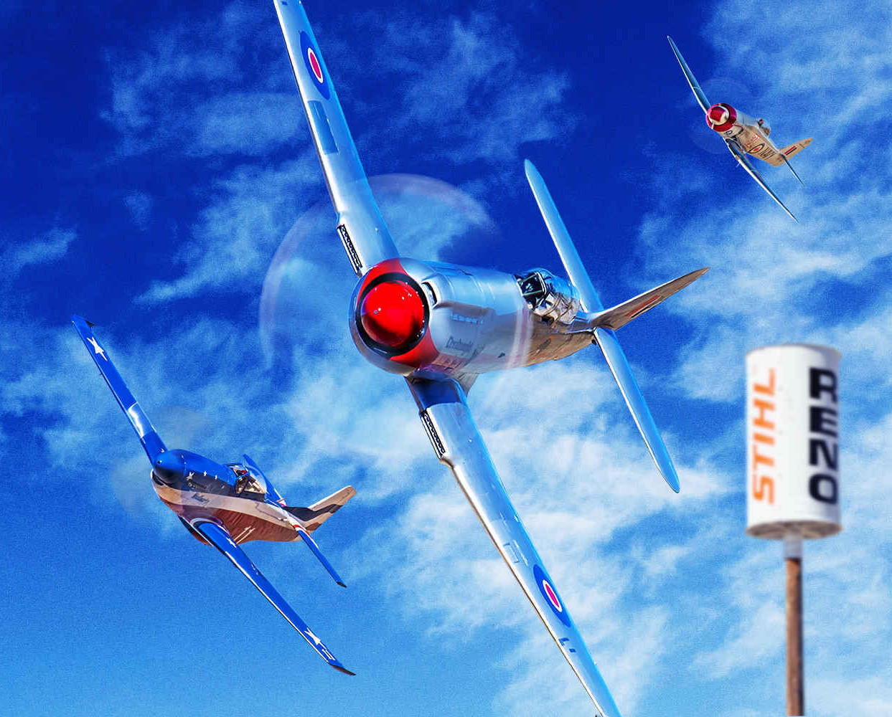
Three Major Types of Air Racing
1. Pylon or Closed Course Speed Races:
Think Red Bull or Reno Air Races using highly modified racing planes
Notes:
People often ask how the Air Race Classic is structured.
Well, there’s primarily THREE types of Air Races held
The first is Pylon or closed course like Reno – the Fly fast and turn left races that are flat out speed races
There are also Rally or Derby type races that focus on proficiency or specific skills or solving puzzles. We also host the annual one day ARC Air Derby in the fall.

Slide 10
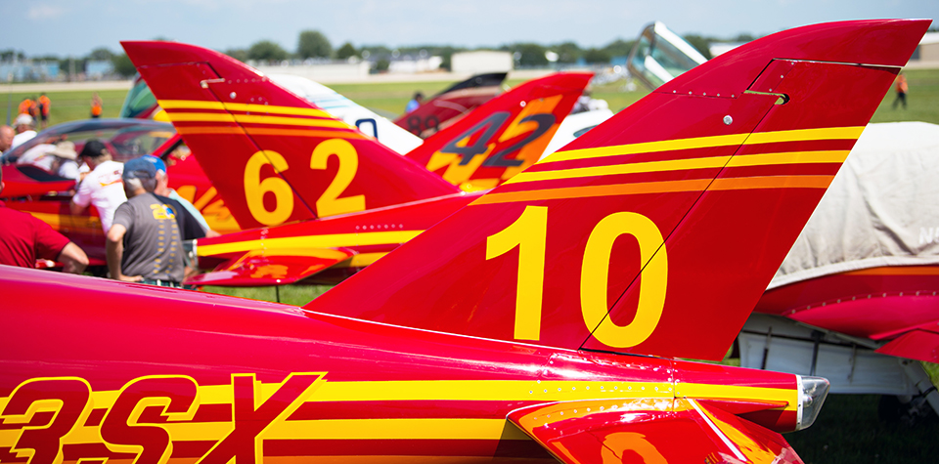
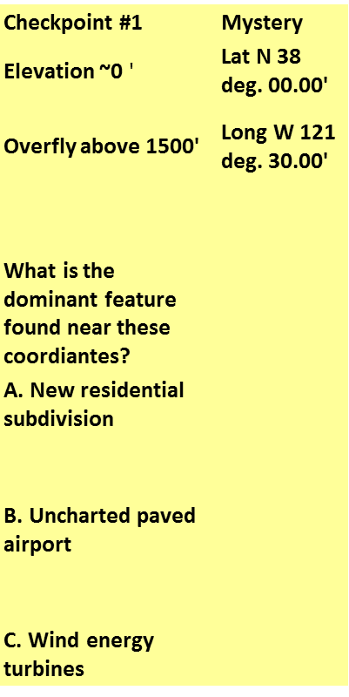
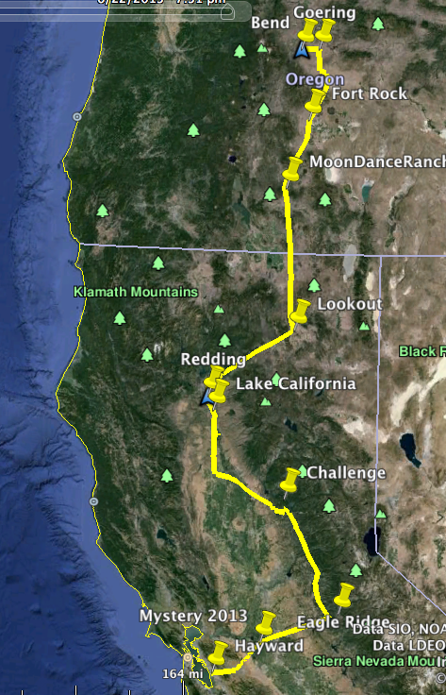
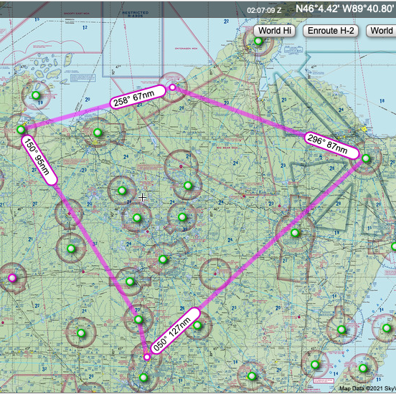
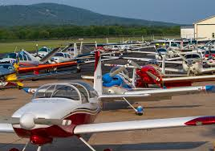
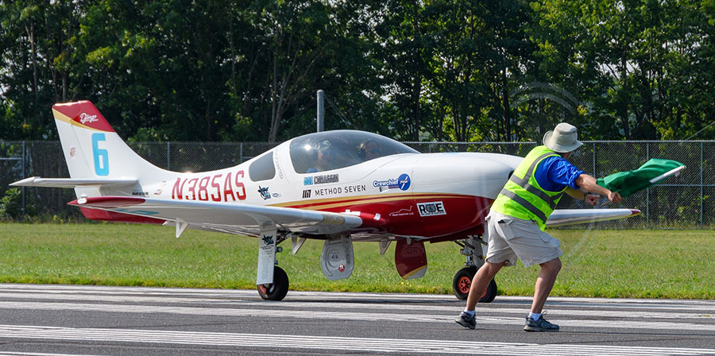
Three Major Types of Air Racing
2. Rally Races:
focusing on flying skills/proficiency/trivia, and adventure using just about any aircraft type willing to enter
Notes:
People often ask how the Air Race Classic is structured.
Well, there’s primarily THREE types of Air Races held
The first is Pylon or closed course like Reno – the Fly fast and turn left races that are flat out speed races
There are also Rally or Derby type races that focus on proficiency or specific skills or solving puzzles. We also host the annual one day ARC Air Derby in the fall.

Slide 11
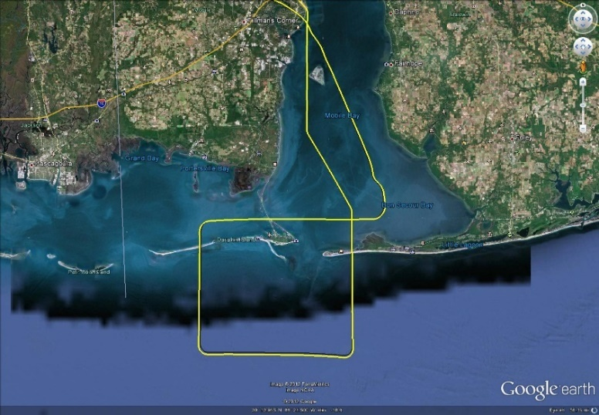
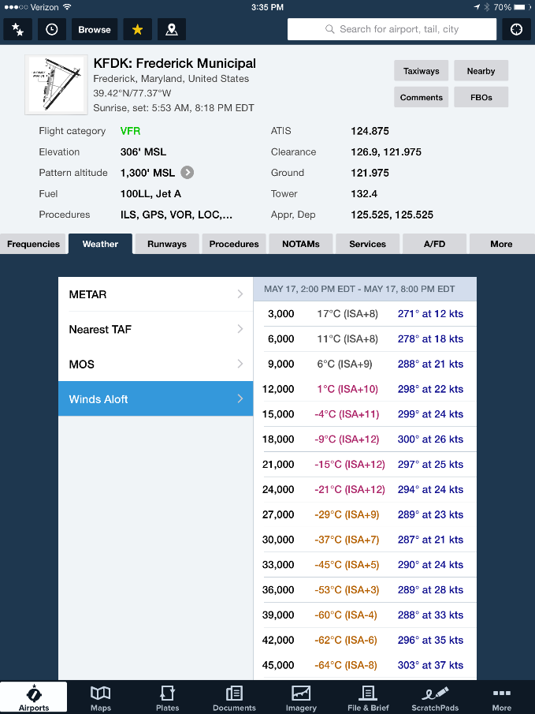
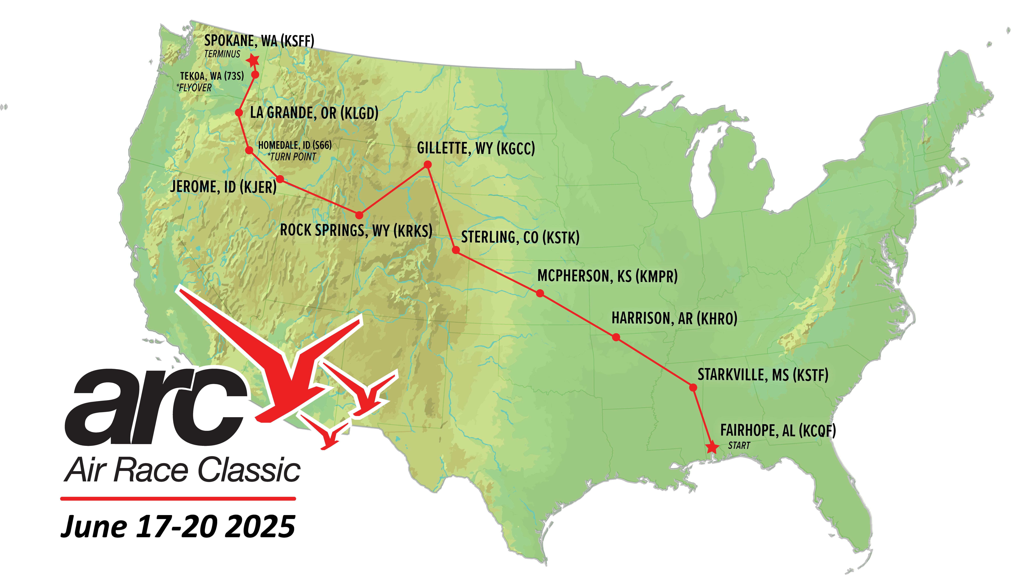
Three Major Types of Air Racing
3. Handicapped Speed Races:
using specific aircraft types approved for that specific race. Racers use strategy to beat an assigned handicap speed over a posted course
The Air Race Classic is a
Handicapped Speed Race
Notes:
And, the third type is a Handicapped race that is limited to specific aircraft that are approved to participate.
The racers use various strategies like what altitude has the best winds to beat their assigned handicap speed over the posted course.
We will talk more about handicap and strategy in a bit

Slide 12
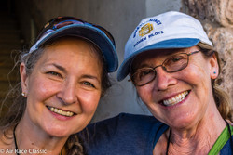
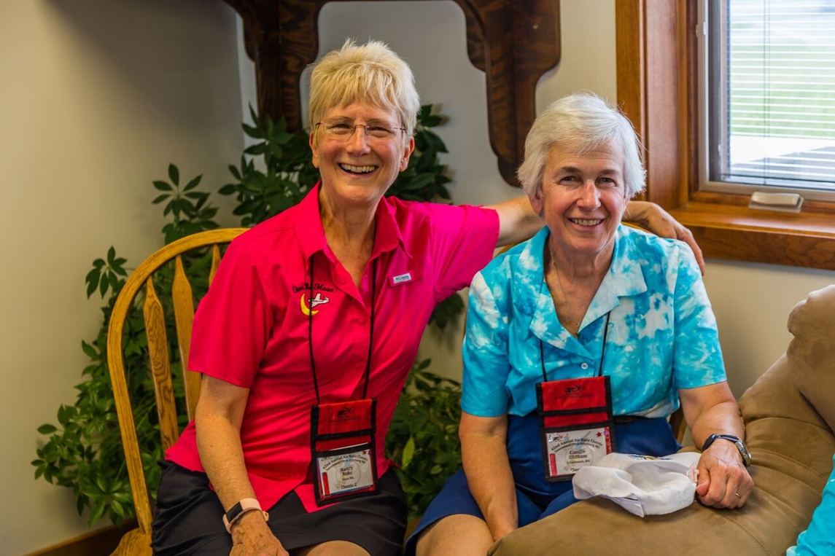
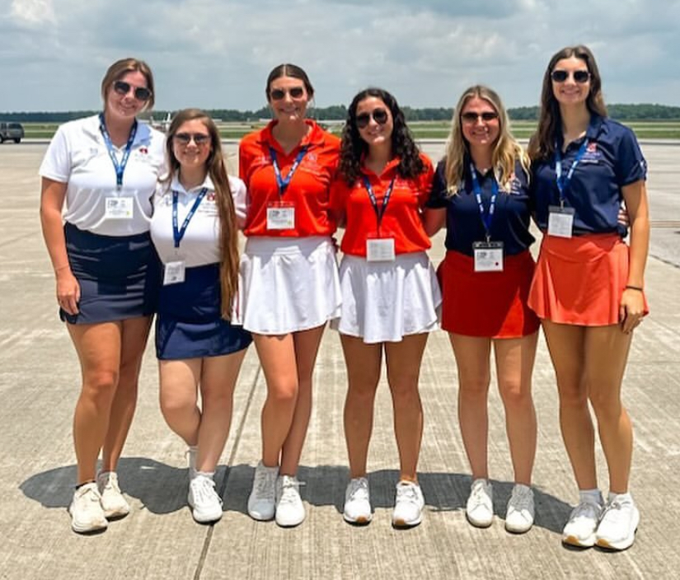
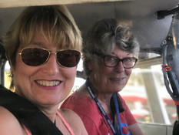
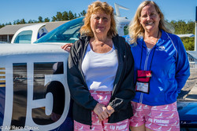
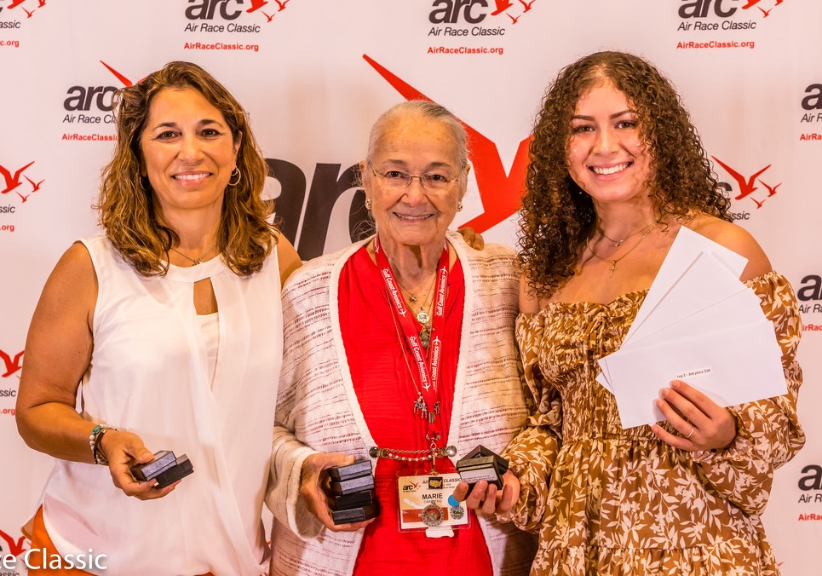
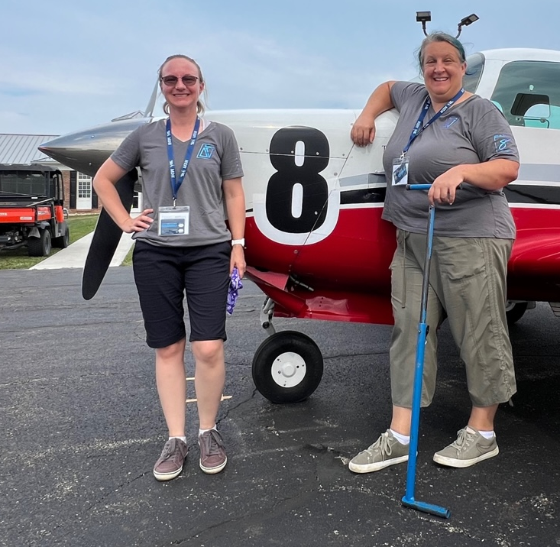
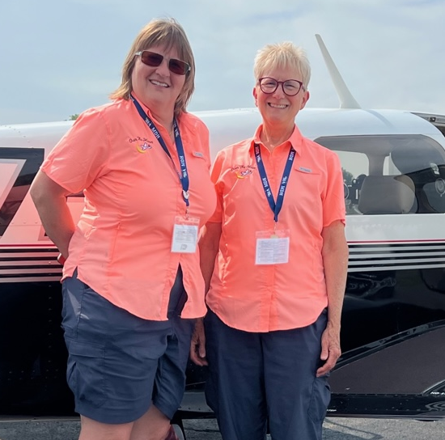
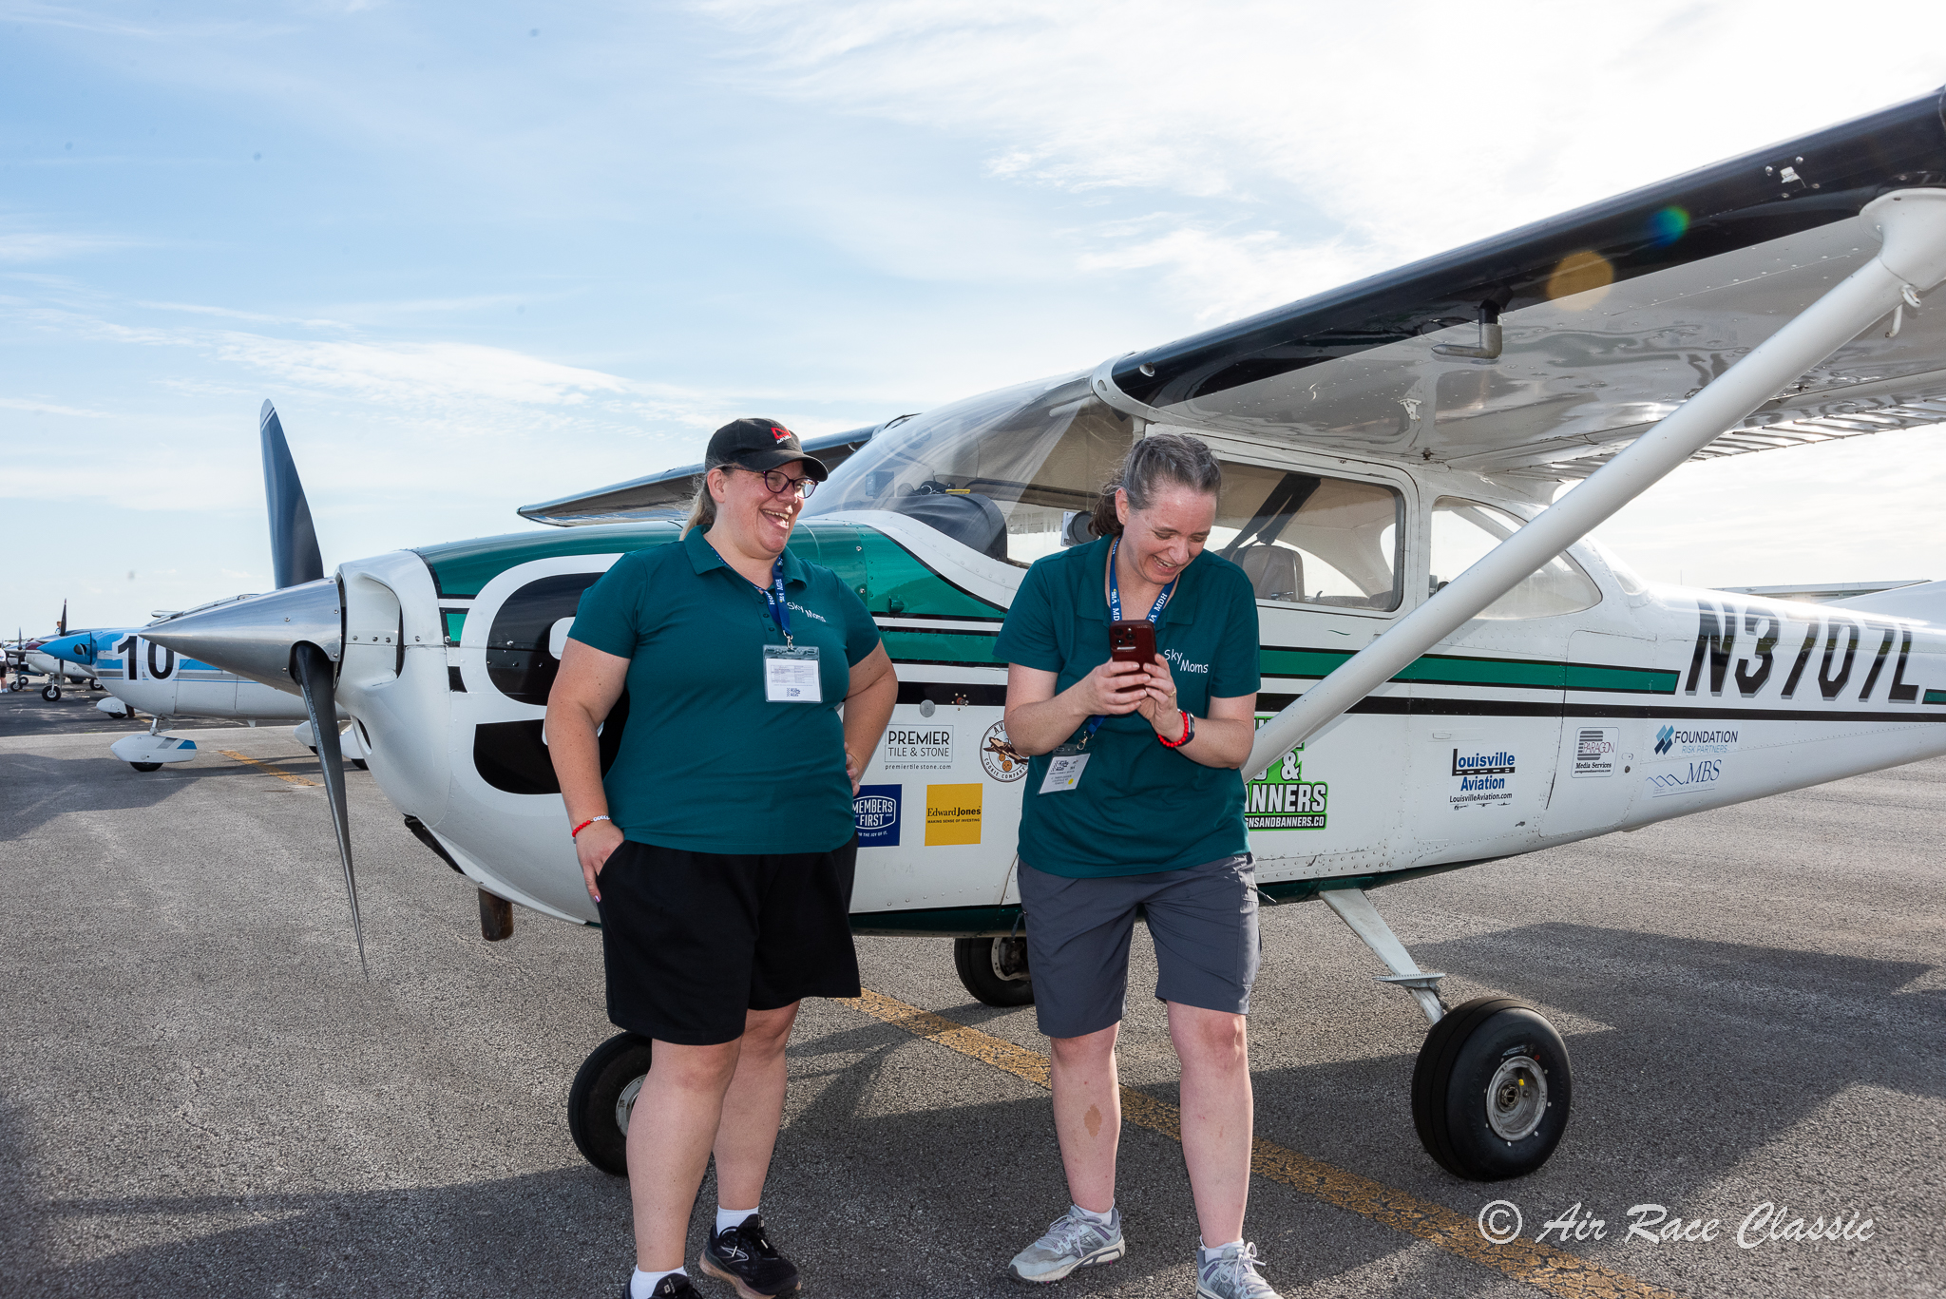
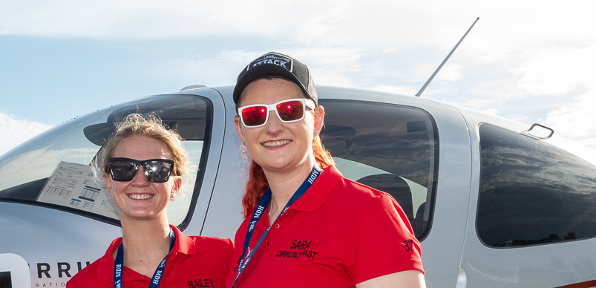
Who Races in the Air Race Classic?
Notes:
Emmy

Slide 13
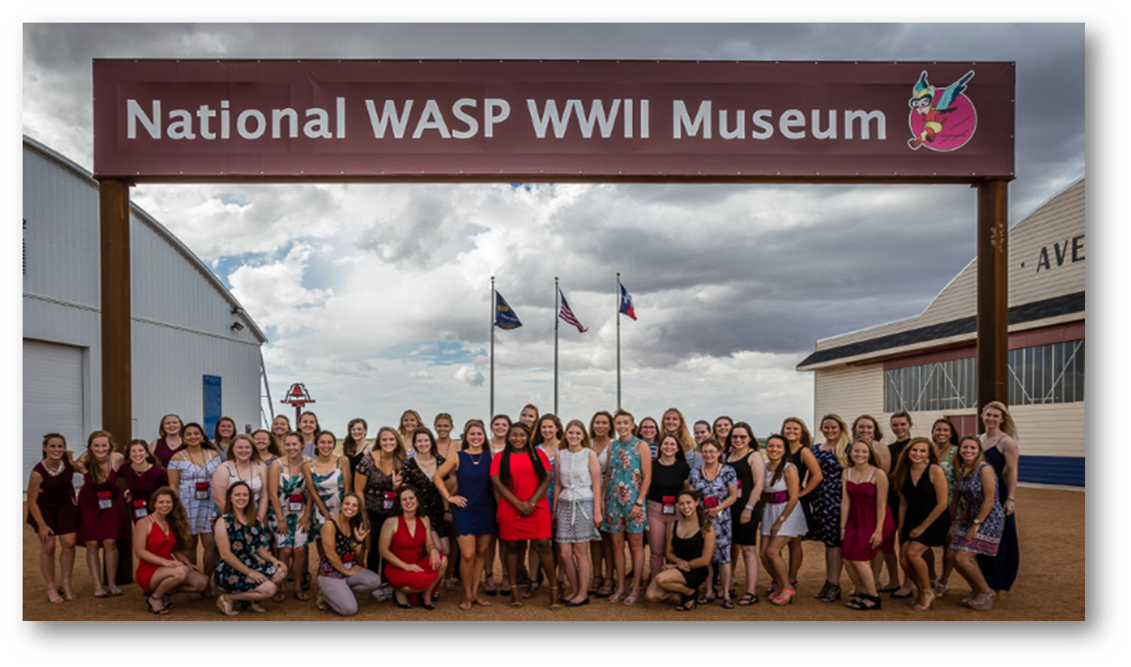
Collegiate Teams
Notes:
Emmy

Slide 14














2024 Collegiate Teams
Notes:
Emmy

Slide 15
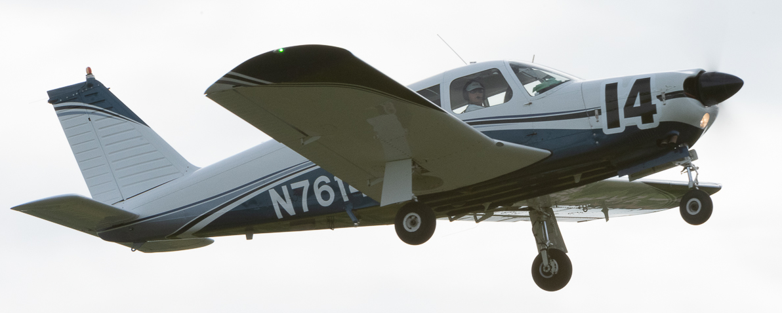
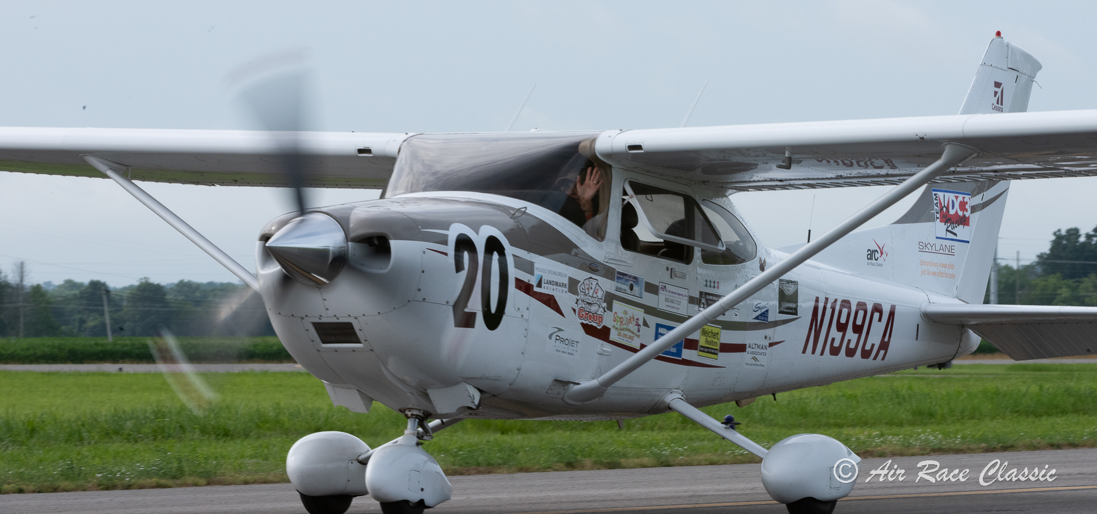
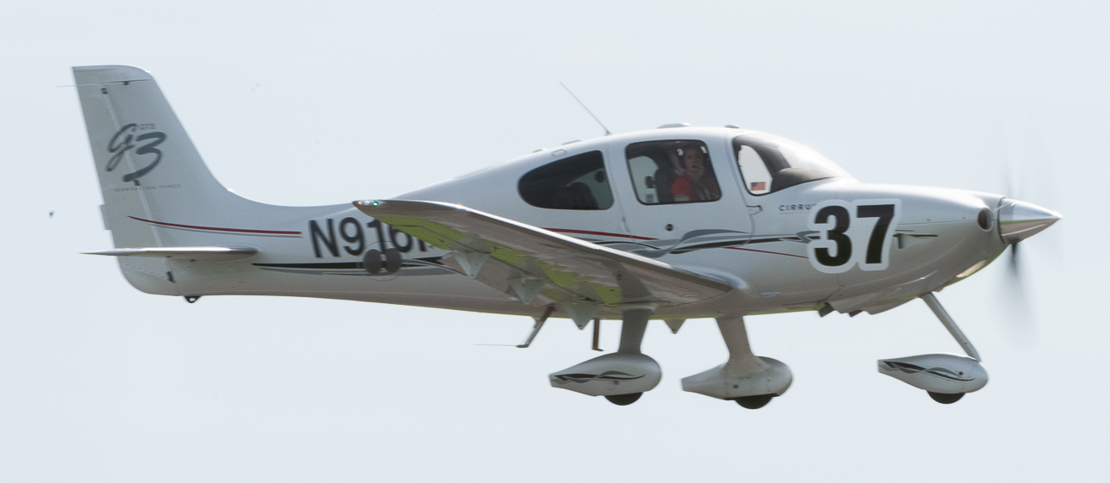
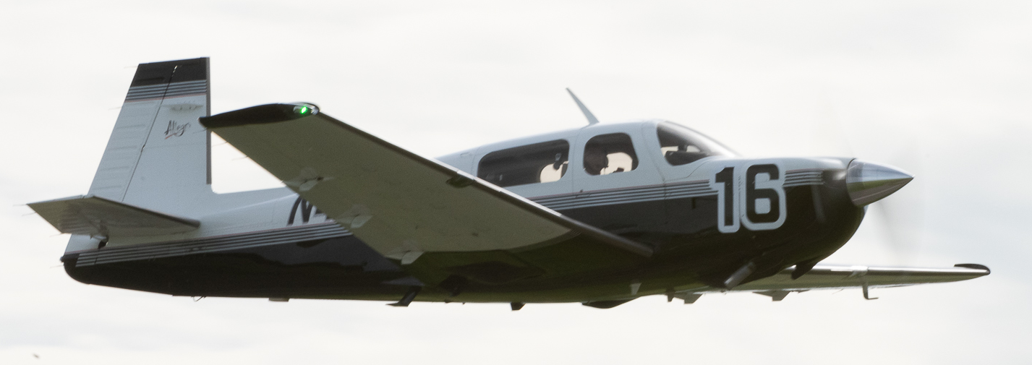
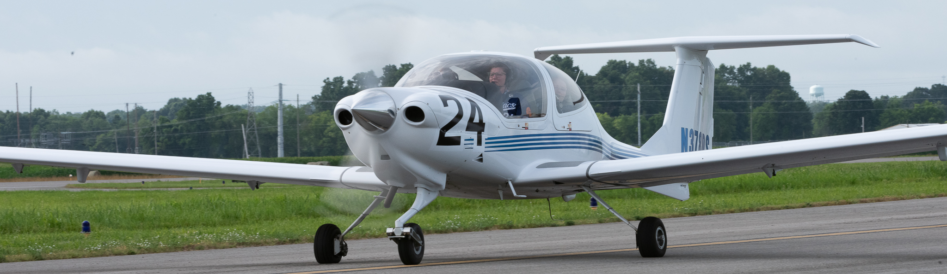
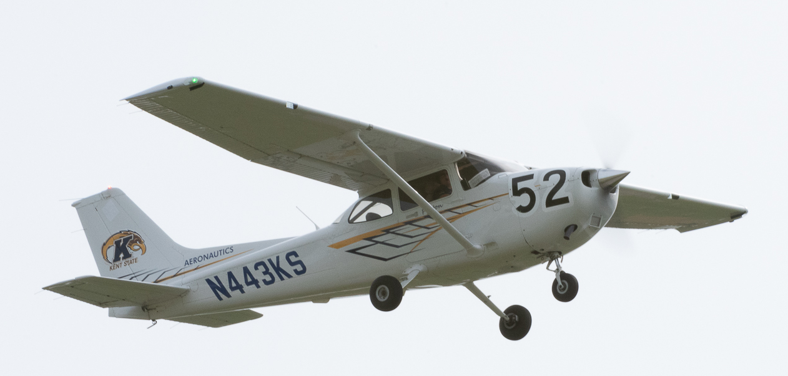
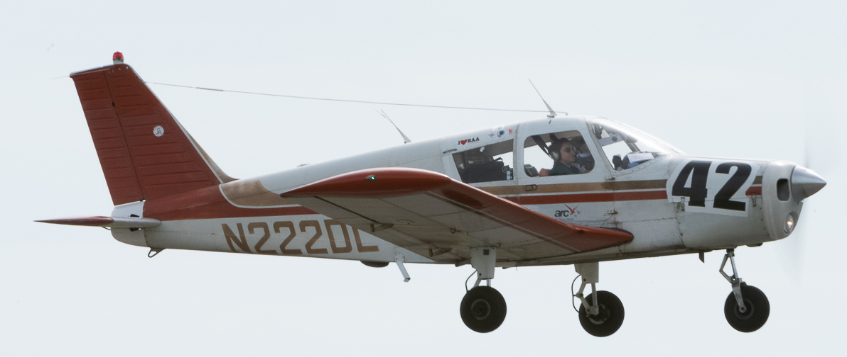
What Airplanes Can Race?
Notes:
Lara

Slide 16
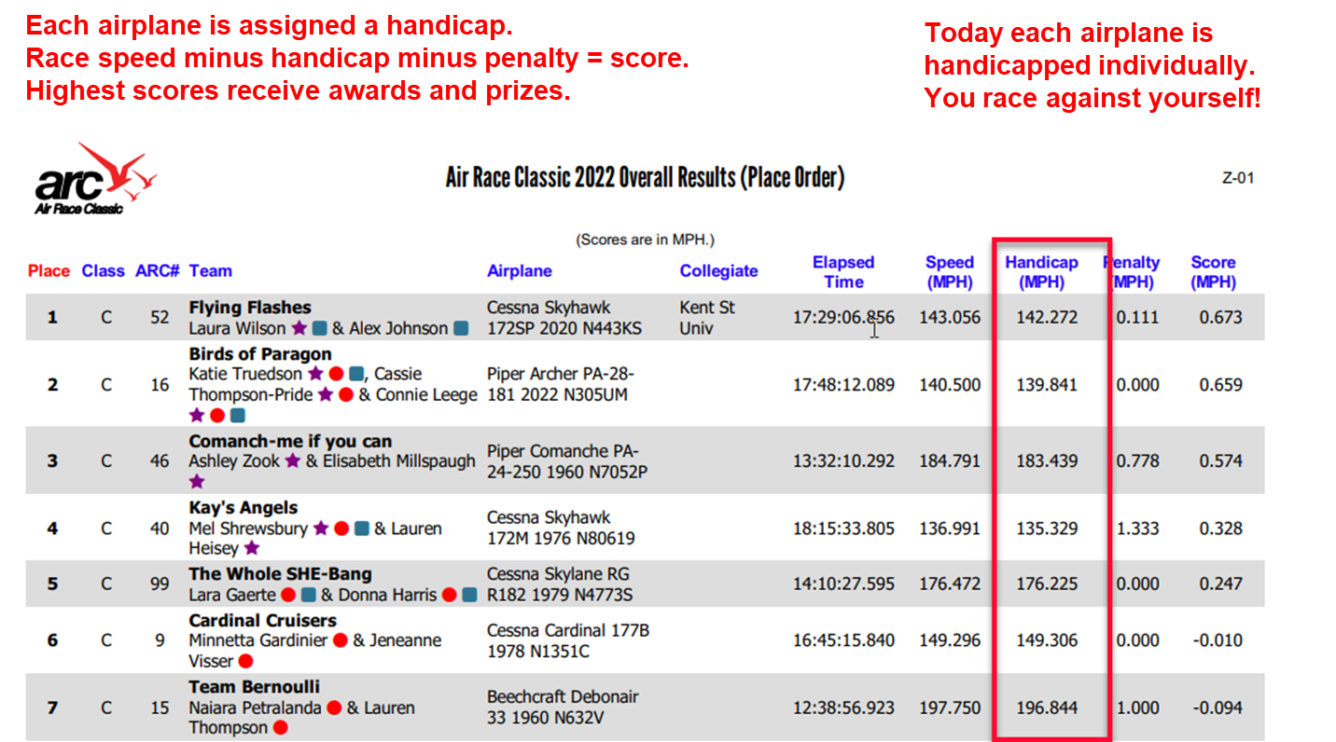

Handicaps
Notes:
Lara

Slide 17
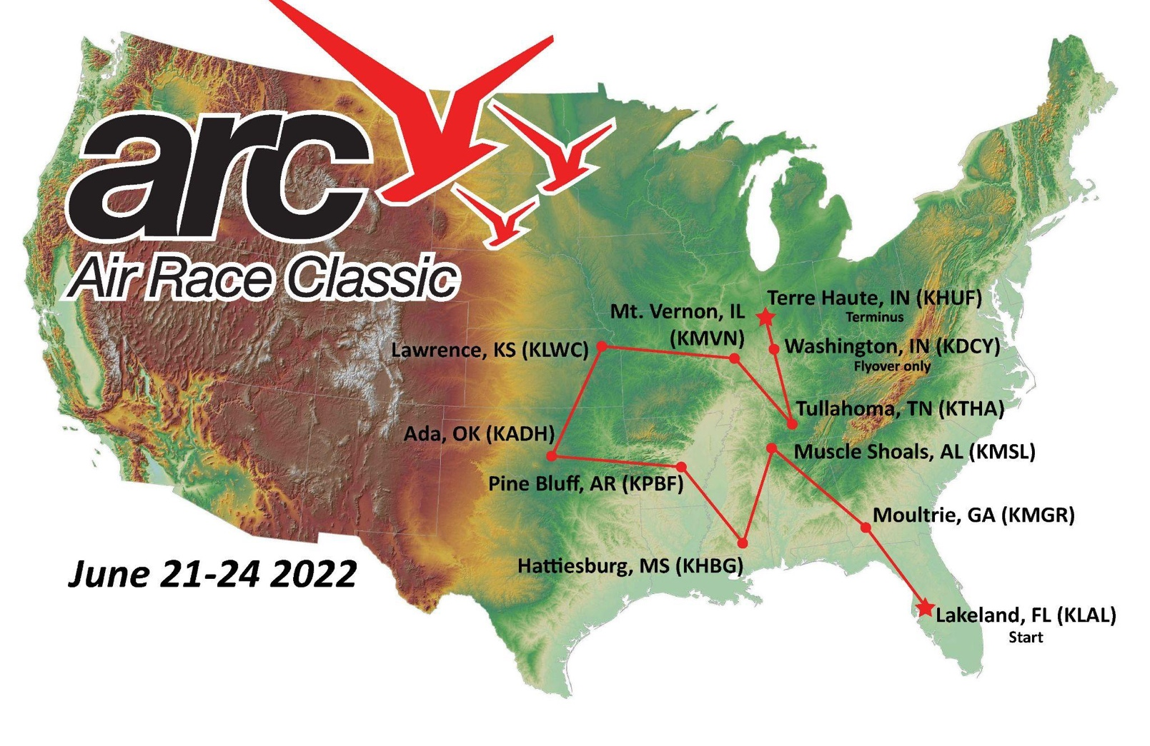
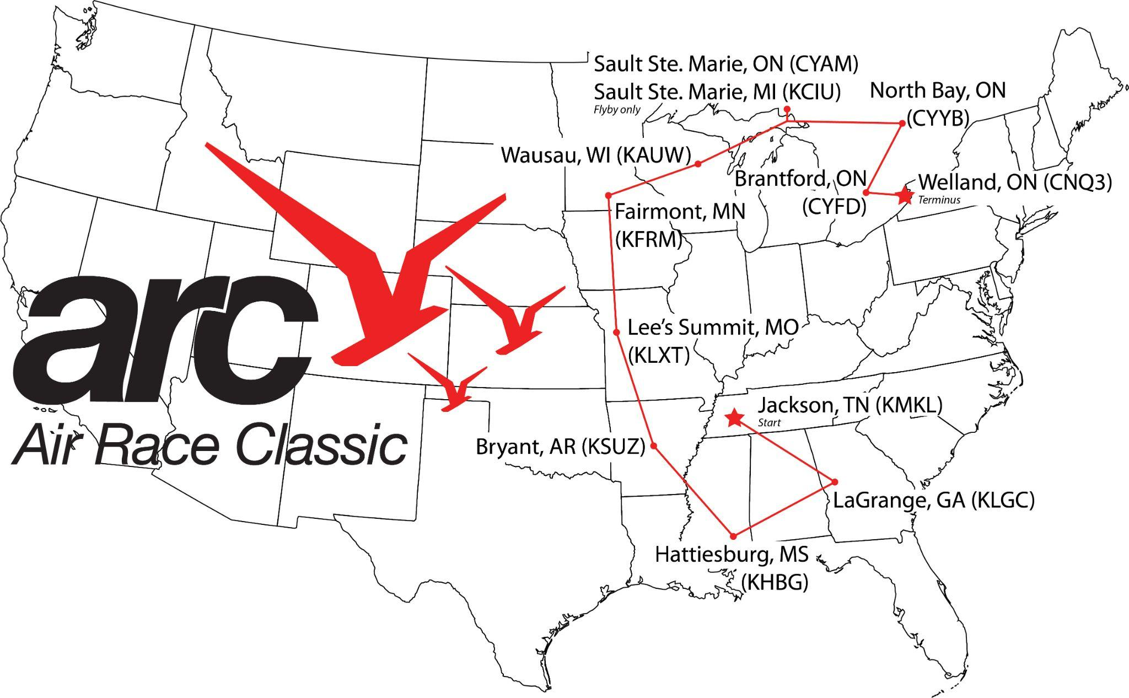

Recent Routes
2019 ^
<- 2014
Notes:
Theresa

Slide 18






Flybys, Timing, Stop Volunteers
Notes:
Theresa

Slide 19
2025 Route
Notes:
Theresa
Are there any questions before we get into the Day in the Life of a Racer?

Slide 20






A Day in the Life of an ARC Racer
Arrival to Start
Prepping for Safety Checks
Clearing Credentials
Notes:
Emmy:
We like to call our time together in June as “Fly Camp”
Over the time at the start, during the race and at the terminus you are eating, drinking and dreaming about racing!
We typically arrive the Friday before the Tuesday launch to prep our planes for Safety Checks,
and to have our pilot and aircraft logbooks reviewed for currency and accuracy – this can definitely be a learning experience.
Teams work their way through the various stations we have set up for these Start check-in activities – you can see on the bottom left our progress board that shows where each team is in the process.

Slide 21



A Day in the Life of an ARC Racer
Notes:
Emmy:
We like to call our time together in June as “Fly Camp”
Over the time at the start, during the race and at the terminus you are eating, drinking and dreaming about racing!
We typically arrive the Friday before the Tuesday launch to prep our planes for Safety Checks,
and to have our pilot and aircraft logbooks reviewed for currency and accuracy – this can definitely be a learning experience.
Teams work their way through the various stations we have set up for these Start check-in activities – you can see on the bottom left our progress board that shows where each team is in the process.

Slide 22







A Day in the Life of an ARC Racer
Briefings
Team Building
Youth Event
Racing!
Notes:
Emmy:
Then we get to spend a day and a half in briefings to discuss in detail the race course, the rules, and how to fly those exciting and adrenaline filled fly-bys at each stop.
But it’s not all work and no play! We have lots of opportunity to team build, meet the other race teams, and share our passion with local youth at outreach events.
The Start and Terminus host informal events and more formal banquets for us.
Once we start racing, as Theresa mentioned, when we stop for fuel and or to overnight or just take a break, we sign a “Remain overnight” sheet for safety and to provide an order for takeoff the next morning.
The public can track us via our SPOT trackers we all carry – our location is displayed on a moving map via MAProgress, which can be accessed from our website.

Slide 23






A Day in the Life of an ARC Racer
The Views
The Stops
The Fun
Notes:
Emmy:
We often get asked why we race –
Well, most of us are very competitive but where else can you see the US as low level
When else can you stop and make friends across the country
Why else would you do it? Ask us! We’ll tell you!!
Just to note – more times than not, the stops are hosted and staffed by 99s chapters – like the one Ramona Banks chaired in Alabama for us last year.
There’s some downtime during the race during the evenings or when waiting for weather or strategy windows
And then, if you get lucky, you get to take home some bling and maybe some cash!
After its said and done, you just made a lot of new life-long flying friends!

Slide 24



Finding Teammates
Enter as a Racer – Free: https://airraceclassic.org/how-to-register.htm
  You’ll also find the Rules there!
Instagram: @airraceclassicinc
E-mail Entry Admin: entryadmin@airraceclassic.org
Air Race Classic Facebook Group: Air Race Classic Group
Provide brief info about yourself like, “250 hr instrument rated private pilot near KFDK looking to join a team. I raced in 2016”
Notes:
Emmy:
Another big question we get is
I want to race but don’t have a plane or
I want to race and have a plane but don’t have a copilot
We want you to join us so here are a few suggestions on how racers have found other racers to make a team
First, enter as a racer…..
Join our Facebook Group
Follow our Instagram
Email Entry Admin
Provide a brief summary of your qualifications when you post or contact us so we can help match you up

Slide 25
Basic Qualifications
For You:
Private or higher airman's certificate with a rating for the class airplane to be flown;
Minimum 100 hours PIC
Current medical certificate or BasicMed documents;
Proof of required flight review or added rating;
Either the pilot or copilot must have a minimum of 500 hours PIC or a current instrument rating by credentialing at Race Start
Notes:
To learn more about Racer, Team, and Airplane qualifications
Go to the GET INVOLVED Tab across the top page of our website and click on
Qualifications
Theres also details on how to register or purchase a special race number if you’d like to do that
And
If you’d like to volunteer to help at a stop or with administration of the race
Click on the How to Volunteer link

Slide 26
Basic Qualifications
For Your Plane:
The Competition Class are open to single- or twin-engine airplanes that are certificated in the normal or utility category, with normally aspirated engines between 100 and 600 horsepower rated for continuous maximum operation (no limitations) at full take-off power
Airplanes that don't meet these qualifications may qualify for the Non-Competition Class
Intercollegiate Class follows similar qualifications as the Competition Class
Notes:
To learn more about Racer, Team, and Airplane qualifications
Go to the GET INVOLVED Tab across the top page of our website and click on
Qualifications
Theres also details on how to register or purchase a special race number if you’d like to do that
And
If you’d like to volunteer to help at a stop or with administration of the race
Click on the How to Volunteer link

Slide 27





Register or Get More Information
Create an account or log in
(if you’ve ever raced or volunteered
before don’t create a new account)
Click on 2025 Race Registration
Click on the BLUE “Register” Button to complete your racer registration
No payment is due until a Team is created
Registration is January 2 through March 31
Notes:
It all starts at our website – www.airraceclassic.org

Slide 28

2025 ARC Air Derby
A One-Day, Create-Your-Own-Route Challenge
An opportunity for pilots around the world to challenge their piloting, flight planning, and navigation skills in a fun, 1-day event format.
Co-Ed - Teams consist of at least 2 pilots (one must be a female pilot or female student pilot)
Fly Almost Any Airplane!
Notes:
It all starts at our website – www.airraceclassic.org

Slide 29
How the Derby Works
Submit Design Route (5 legs - > 65nm each)
Once Approved, Submit Flight Plan & Leg Times
Fly Route!
Send in Flight Data
Whoever flies the closest to their planned times, wins!
Notes:
It all starts at our website – www.airraceclassic.org

Slide 30
Why Fly the ARC Air Derby?
Flown in one-day
  3-4 hours of flight time (rental or operating cost)
In your local area – no extra traveling to or from the event
  You can fly it on your own time and save the PTO!
You can fly with more people! Instructor, friends, family, etc.
Great alternative for those unsure if they want to commit to the full 4-day race.

Slide 31

Pilot / Plane Qualifications

Slide 32

Register for the Derby
Registration Opens August 15th

Slide 33



More Information
BEYOND THE POWDER
The Legacy of the First Women’s Cross Country Air Race
Filmed During 2014 race
Available on Amazon or
www.hemlockfilms.com
BREAKING THROUGH THE CLOUDS
The First Women’s National Air Derby
Documentary of the 1929 race released in 2010
SKY GIRLS
The True Story of the 1929 Race
Author Gene Nora Jessen - veteran racer and Mercury 13 test subject
www.airraceclassic.org
Notes:
Are you ready to learn more about The Air Race Classic and its history?
Both Sky Girls and Breaking through the Clouds explore those first pioneers in air racing
While Beyond the Powder delves into the modern day race.
If you are thinking about racing with us, this documentary is a must watch film.
Note that these resources were all written and produced by women – two of which are 99s
After the end of this presentation we have short trailer for Beyond the Powder that you can watch.

Slide 34

Questions?
info@airraceclassic.org | www.airraceclassic.org
Notes:
We’ve covered a lot of ground tonight but I’m sure there are still more questions to answer for you!
We are happy to provide any additional detail you may have
Or you can e-mail us at info@airraceclassic.org
And don’t forget to view our website at www.airraceclassic.org
PLAY TRAILER FOR THE FILM

Slide 35
Important Dates
2025 Air Race Classic Registration Opens:
January 2, 2025
Team Registration Closes:
March 31, 2025
Airplane Registration Closes:
May 15, 2025
Notes:
We’ve covered a lot of ground tonight but I’m sure there are still more questions to answer for you!
We are happy to provide any additional detail you may have
Or you can e-mail us at info@airraceclassic.org
And don’t forget to view our website at www.airraceclassic.org
PLAY TRAILER FOR THE FILM

